Slide 1


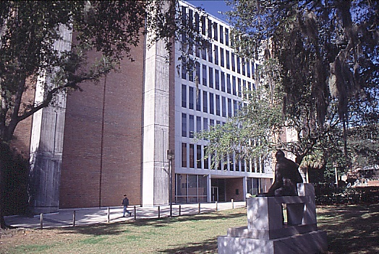
Poster Presentations
Edwin F. Hilinski
NSF-REU Site: Sunshine Institute for the Interaction of Light with Matter
Department of Chemistry and Biochemistry
Florida State University, Tallahassee, FL 32306-4390
Email: efhilinski@fsu.edu
http://www.chem.fsu.edu/hilinski
Recall the components
of an oral presentation given in
“Presenting a Technical Paper”
Acknowledgment - We thank the National Science Foundation Research Experiences for Undergraduates (NSF-REU) Sites program. This material is based upon work supported by the National Science Foundation under Grant No. CHE-2150301.

Slide 2
Poster Presentations
Posters will be presented Thursday, August 1, 2024 from 3:00 to 5:00 p.m. in the CSL lobby.
The boards will be available at 2:00 p.m. on August 1 for you to tack your poster pages to the board. Tacks will be provided. The maximum area for your poster is 42 in tall by 42 in wide.
Use the Poster_Template_240607a.pptx as your guide. When making the pdf file from the pptx file, be sure to click on the “file” tab and then click on “Save as Adobe PDF”. Be sure to look carefully at your poster image from the pdf file to make sure that all appears as you want it to appear in your poster.
**All PowerPoint and PDF files for your poster are to be e-mailed as attachments to Ed Hilinski no later than 5:00 p.m. on July 29, 2024; earlier is acceptable.

Slide 3
Poster Presentations
Dimensions
Before you start entering items into your poster, you need to make one large slide in PowerPoint.
1. In PowerPoint, click on "Design".
2. Click on "Page Setup".
3. Set "Slides sized for:" to "Custom".
4. Set "Width" to "42" inches.
5. Set "Height" to "42" inches.
6. Set "Number slides from" to "1".
7. Set "Orientation Slides" to "Portrait".
8. Set "Orientation Notes, handouts & outline" to
"Landscape".

Slide 4
Poster Presentations
1. Brief and clearly organized
2. Simple with an obvious central point
a. Short text / paragraphs (<20 lines)
3. Easy to read from 1 to 2 meters away
4. Attractive and aesthetically pleasing
a. Mix visual imagery with text
b. Use color appropriately

Slide 5
Poster Presentations
Recommended Font Sizes
Sample Type – Arial Font (others may be used)
Title- 120 point (30 mm tall)
Heading – 60 point (15 mm tall)
Subheading – 30 point (8 mm tall)
Text – 24 point (6 mm tall)

Slide 6
Poster Presentations
Layout Examples
See the next slide
and
the PowerPoint file named
<Poster_Template_230714a.pptx>

Slide 7
Title
Authors
Affiliation
Introduction
1
Materials and Methods
Results and Discussion
7
3
5
Figure
Photo
Figure
Figure
Conclusions
10
Objective
2
4
References & Acknowledgments
11
6
*NOTE: Poster, tacks, and board will be provided; you provide the content.

