Slide 1
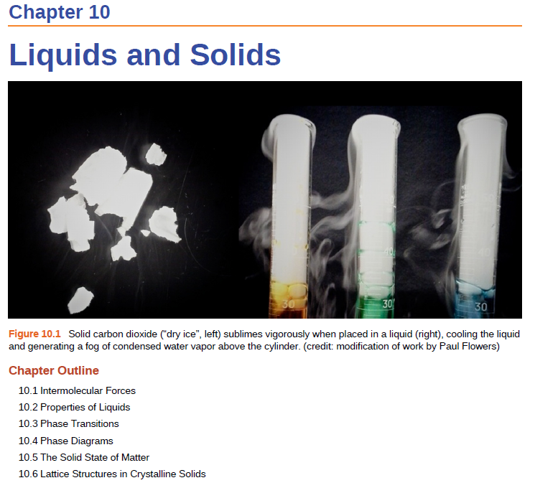


Slide 2
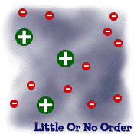



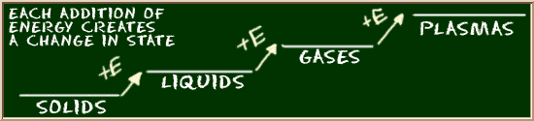
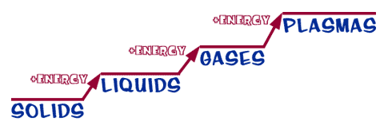
STATES OF MATTER
Solids-
Ionic
Covalent
Molecular
Metallic
Crystalline/polycrystalline/amorphous

Slide 3
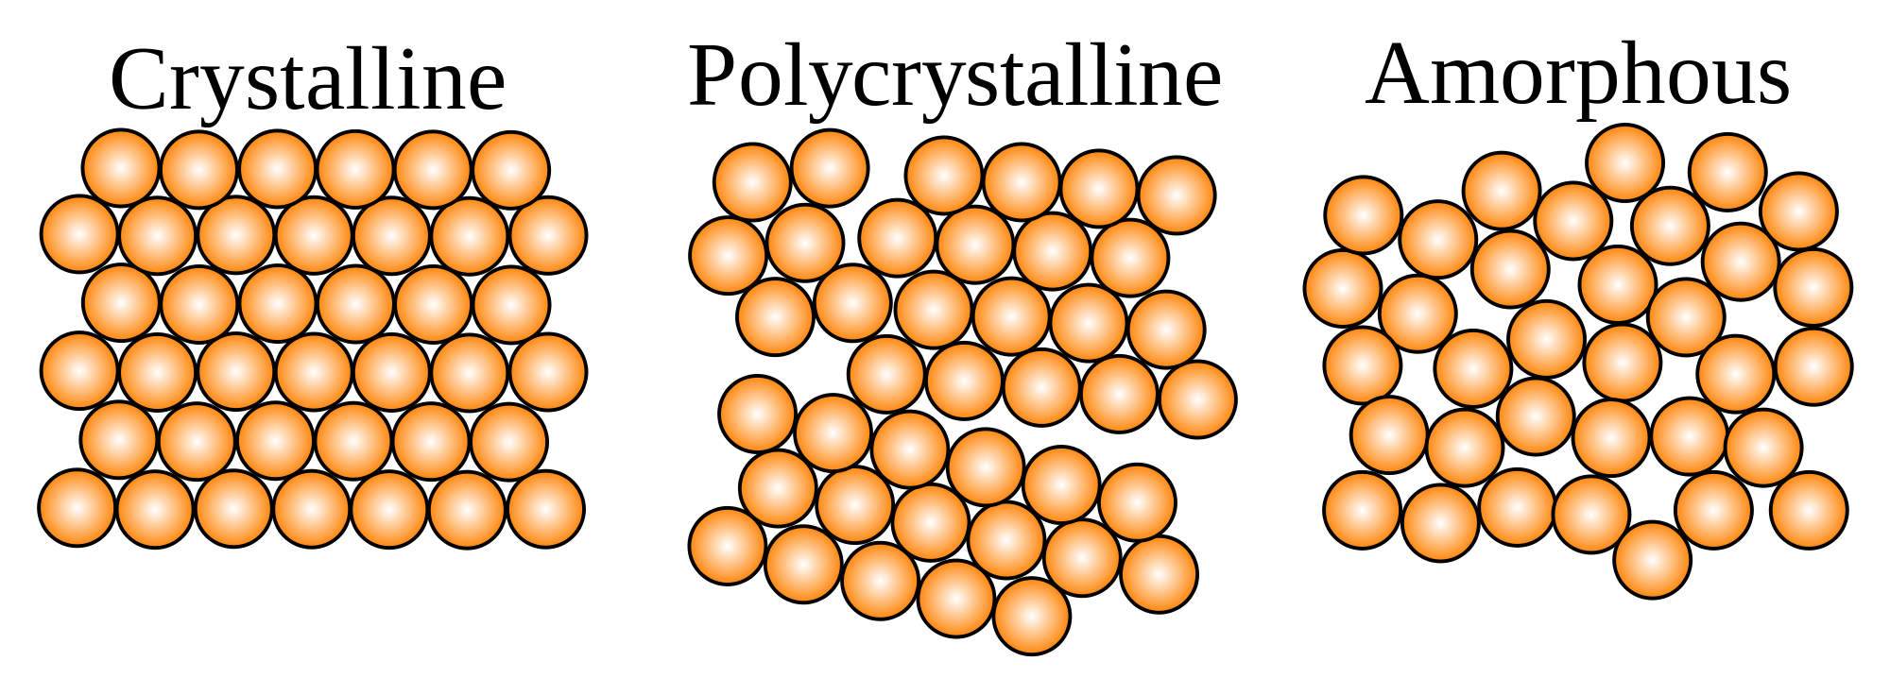
Solids
Crystalline solids
Exhibit a three-dimensional order.
Show diffraction pattern when irradiated with X-rays.
Amorphous solids
Exhibit a short-range order, but
are disordered over the long range.
Do not show diffraction pattern under X-ray irradiation.

Slide 4
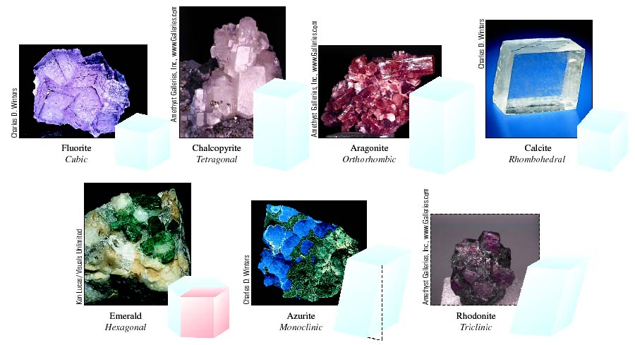
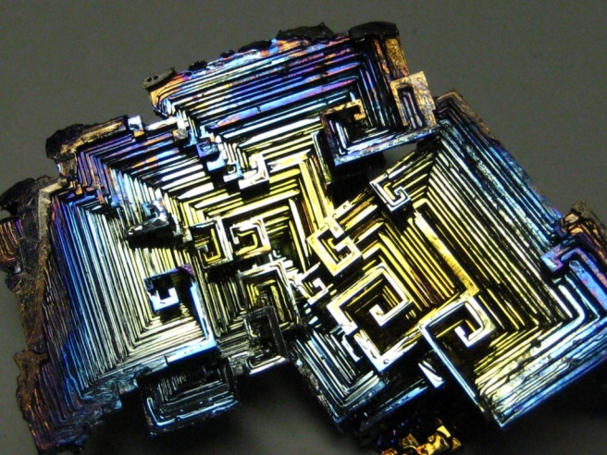
Crystalline Solids
Bismuth Crystals

Slide 5
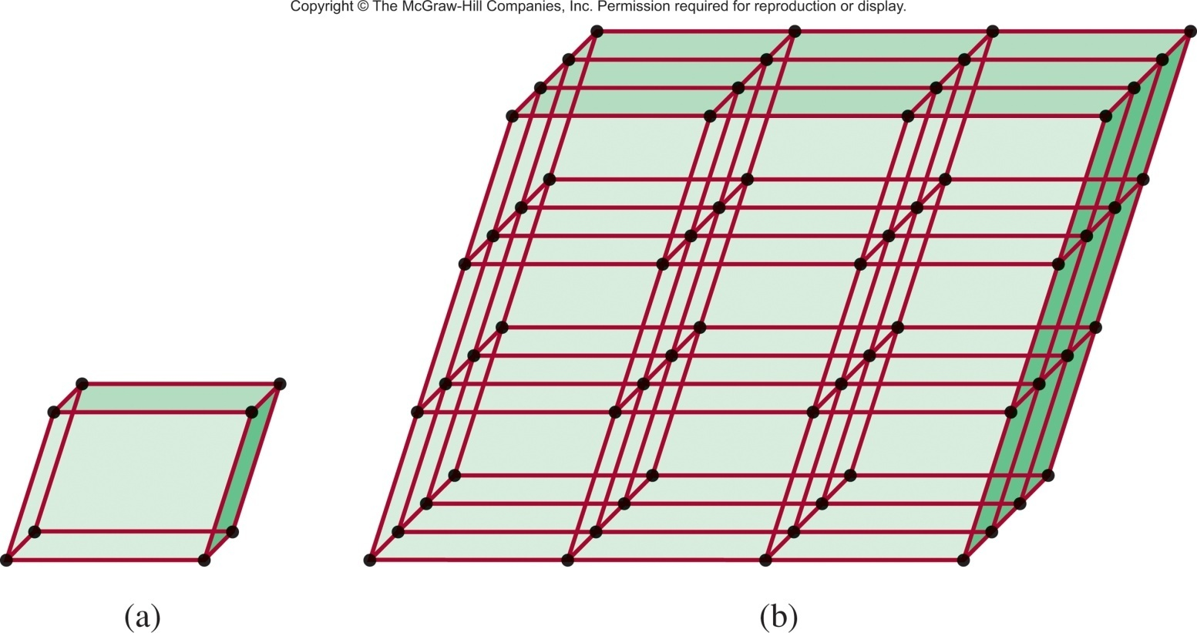
Crystalline Solids
A crystalline solid possesses rigid and long-range order. In a crystalline solid, atoms, molecules or ions occupy specific (predictable) positions.
A unit cell is the basic repeating structural unit of a crystalline solid.
lattice
point
Unit Cell
Unit cells repeat in 3 dimensions

Slide 6
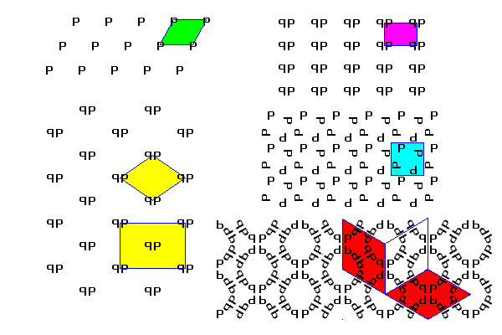
2-D Unit Cell

Slide 7
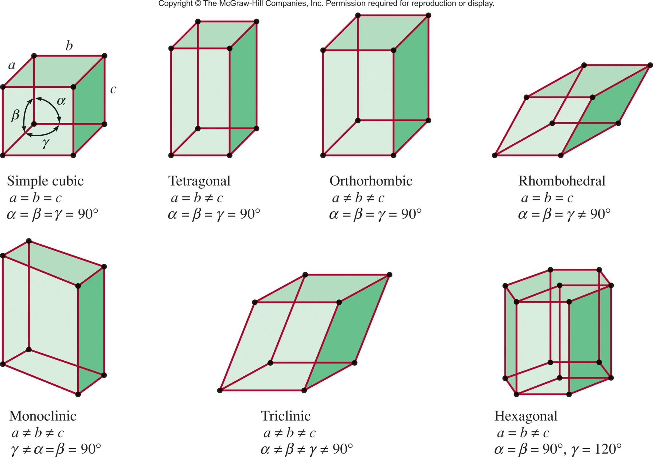
Seven Basic Unit Cells

Slide 8
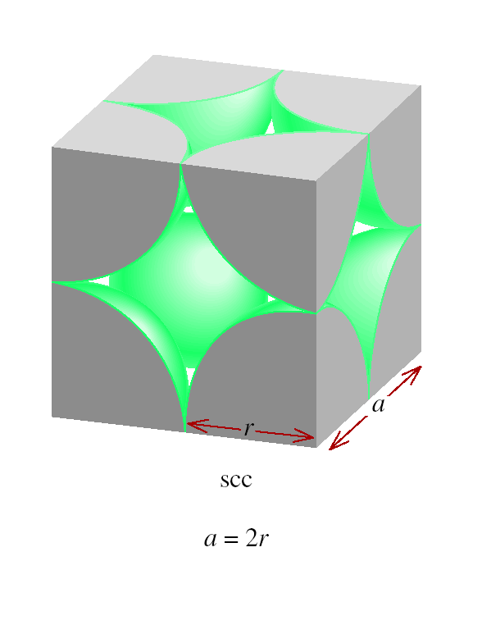
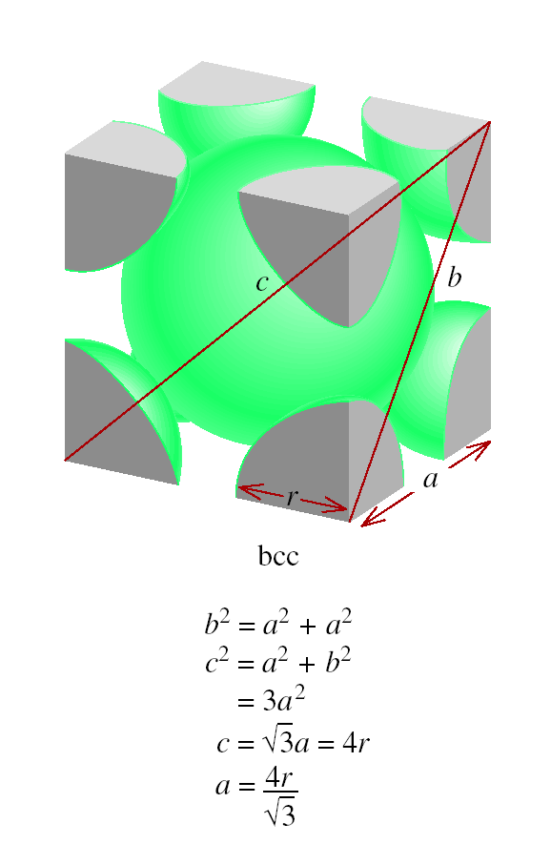
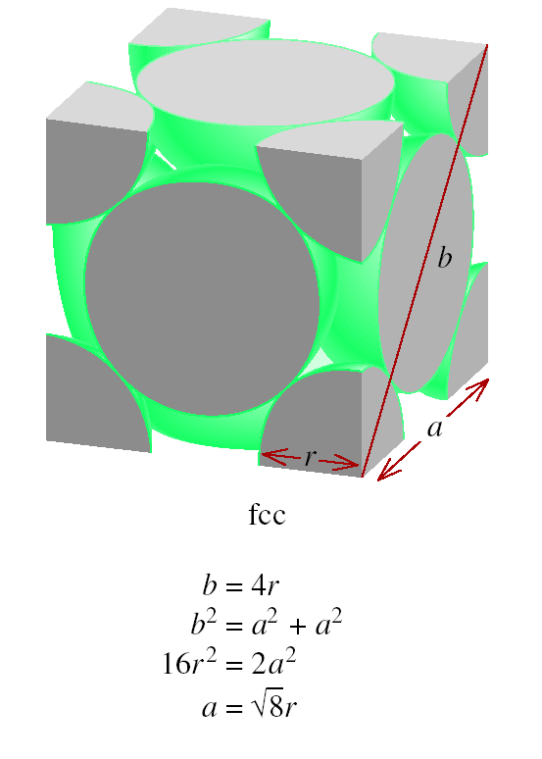
Relation Between Edge Length and Atomic Radius
I am not going to test you on this.

Slide 9
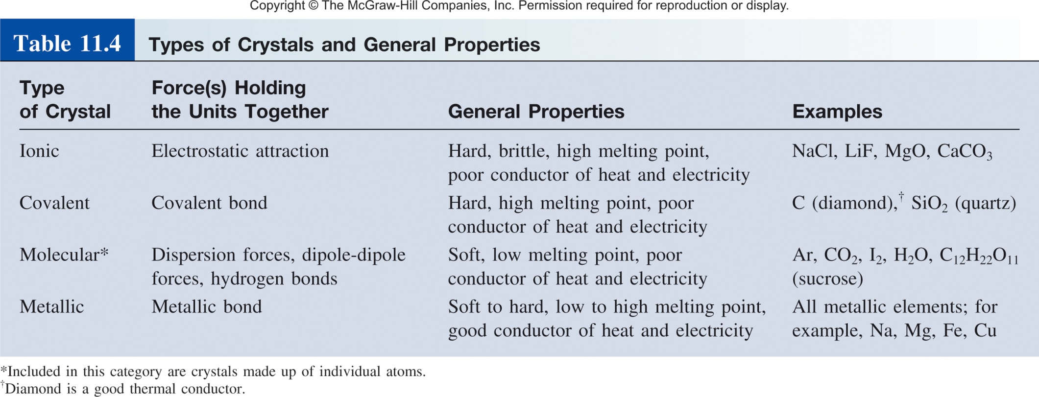
Types and Examples of Crystalline Solids

Slide 10
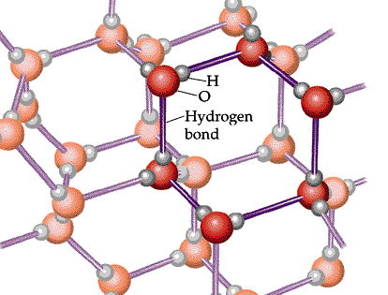
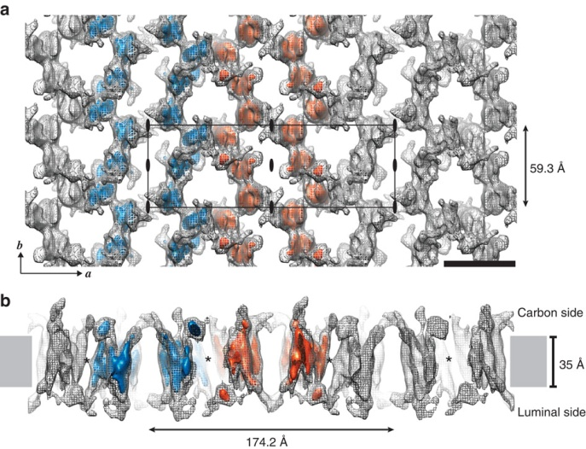
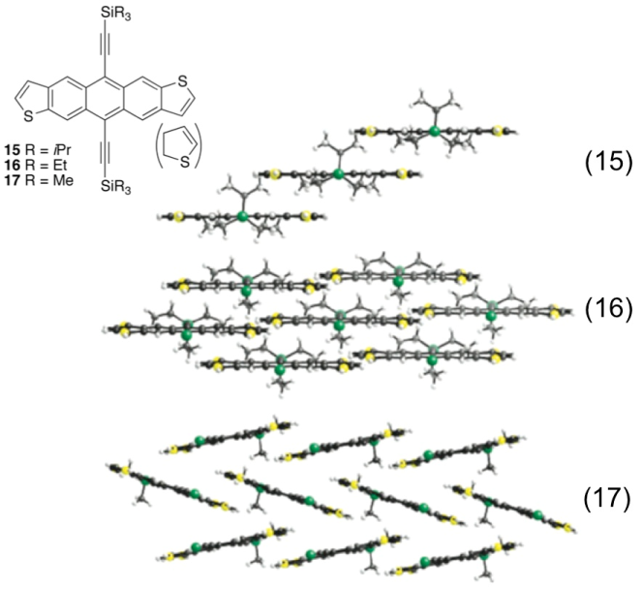
Molecular Crystals
Lattice points occupied by molecules
Held together by intermolecular forces
Soft, low melting point
Poor conductor of heat and electricity
H₂O (ice)
Proteins
Organic Molecules

Slide 11
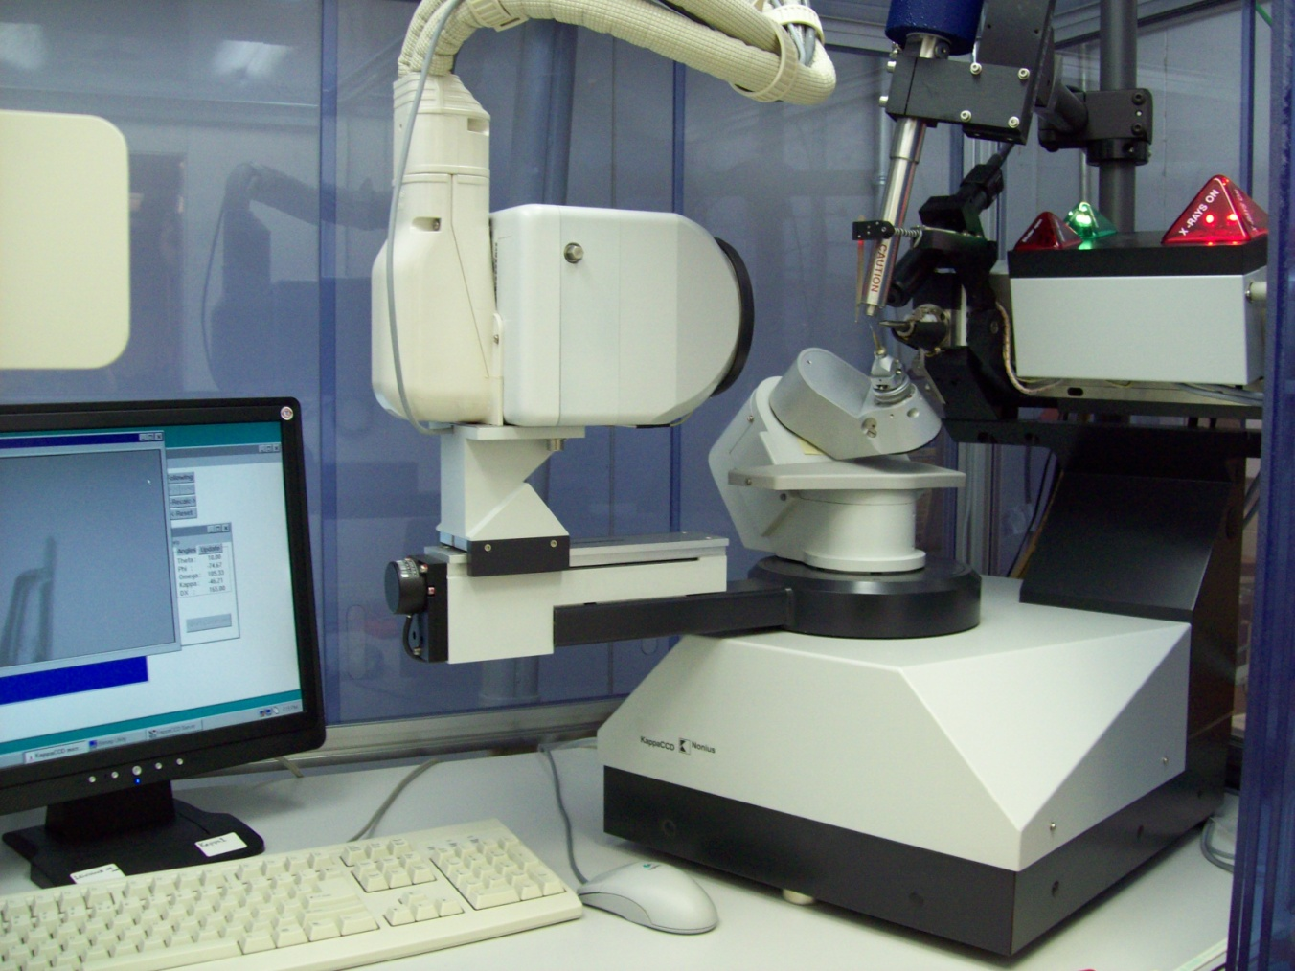
How do we know their structure?
x-ray crystallography

Slide 12
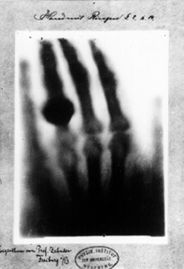
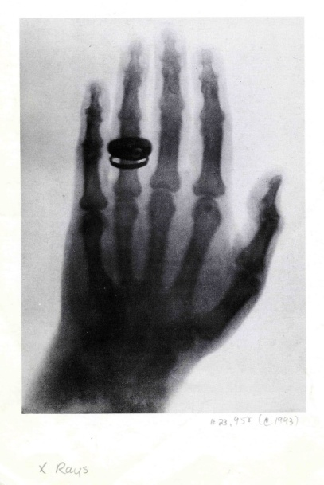
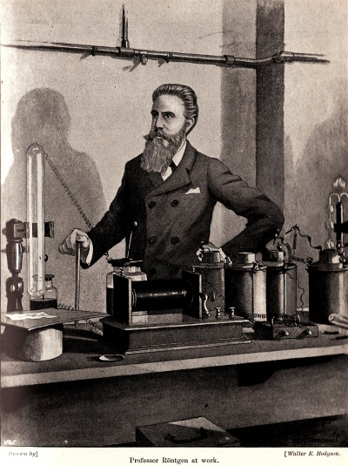
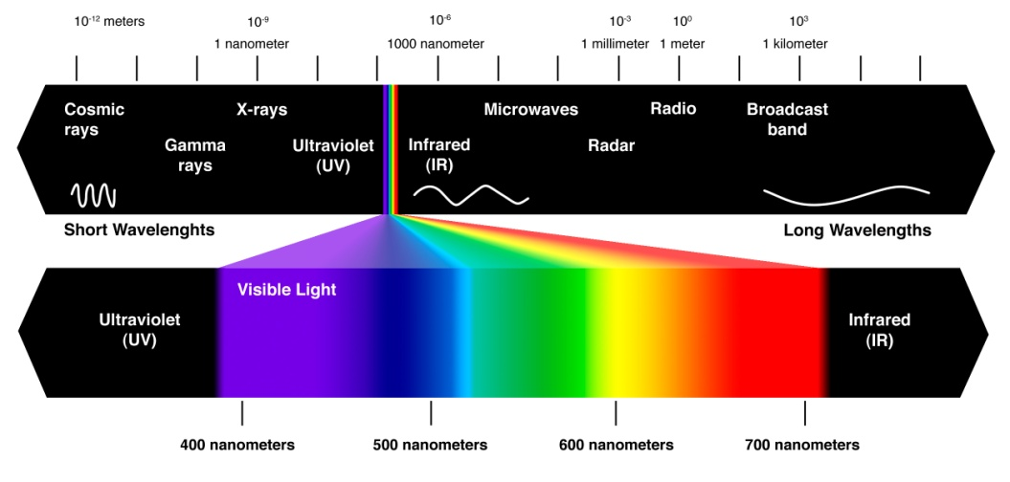
Discovery of X-Rays
The first Nobel prize in Physics
Wilhelm Röntgen (1901)

Slide 13
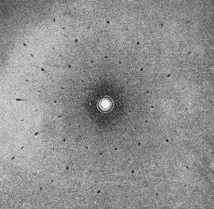
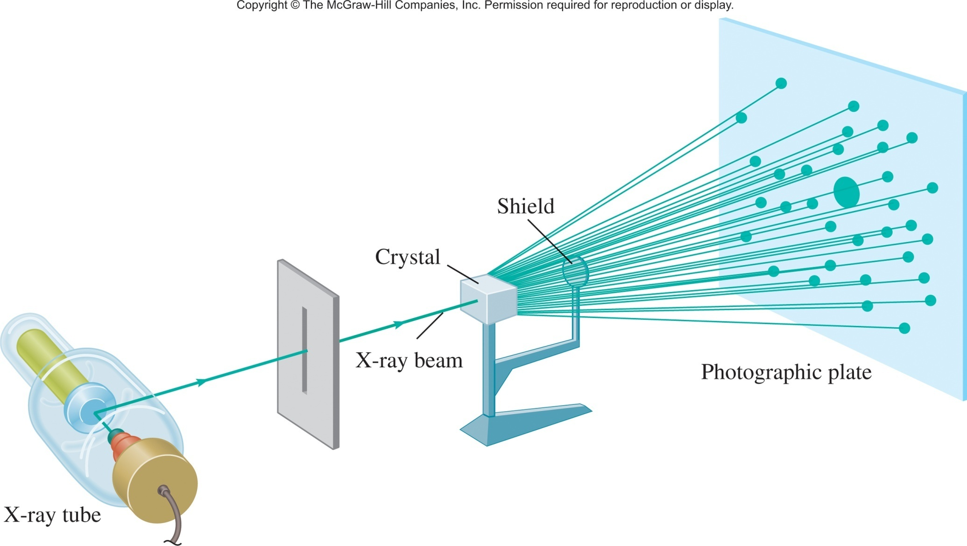
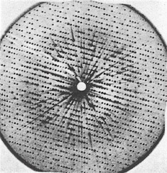
X-Rays Diffraction
NaCl
X-ray Diffraction
Myoglobin

Slide 14
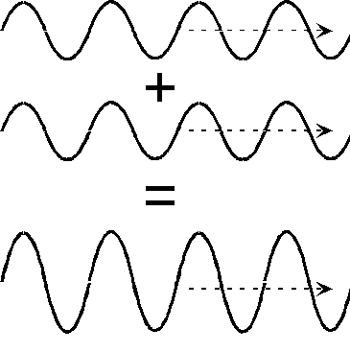
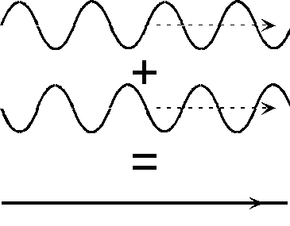
x-ray Diffraction
NaCl
destructively
constructively

Slide 15
Diffraction
Can be observed for any kind of waves
When diffraction occurs from several periodically arranged objects, the waves add up (interference) to produce maxima and minima of intensity
To achieve this effect, the distance between the objects should be comparable to the wavelength
In crystals, interatomic distances are on the order of 10⁻¹⁰ m = 1 Å
Hence, the X-rays!

Slide 16
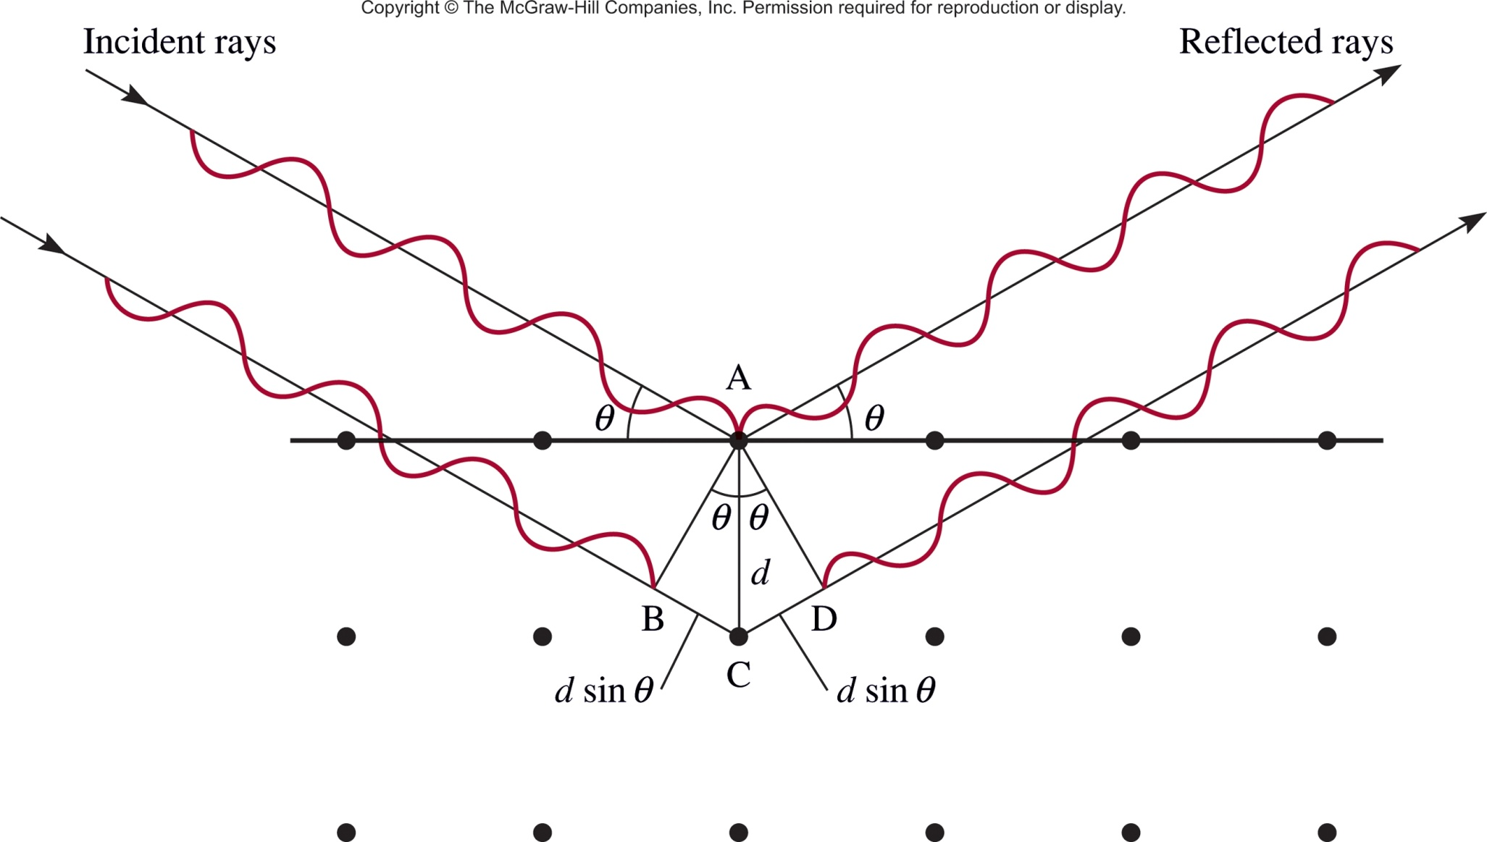

X-Ray Diffraction
Constructive Interference
Will only be constructive (give a spot) if:
the length of (B to C + C to D)
=
[ ]
n

Slide 17
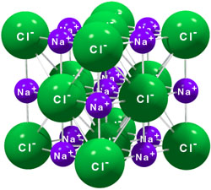
X-Ray Crystallography

Slide 18
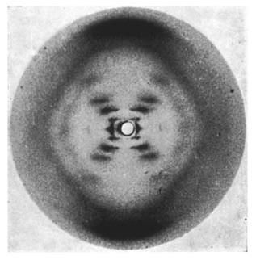
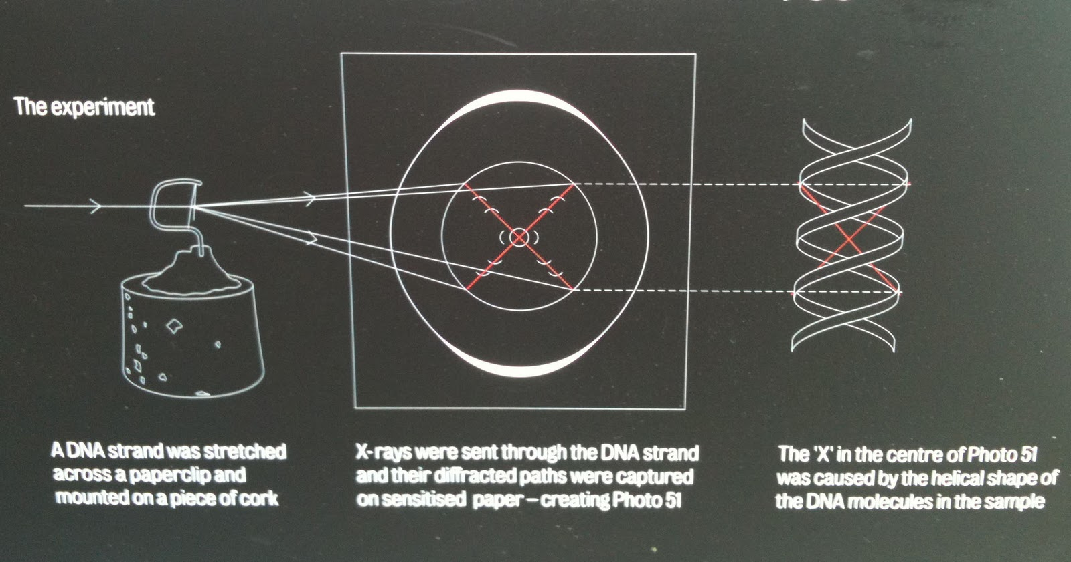
Diffraction
Photo 51
Rosalind Franklin

Slide 19
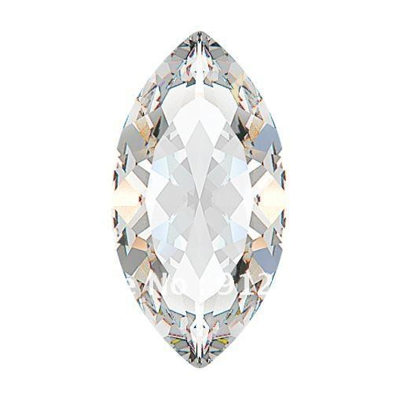
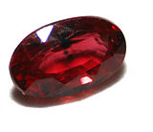
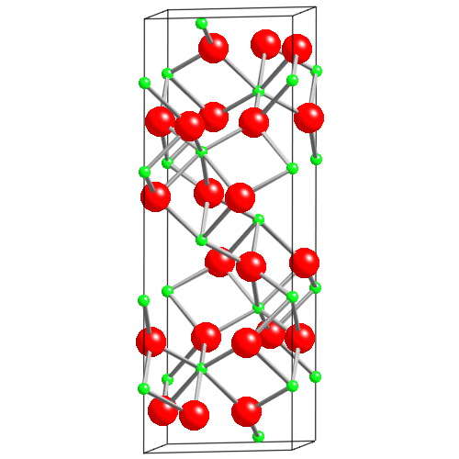
Crystals Side Note
Al₂O₃
Ruby
Replace
1% Al³⁺ with Cr³⁺
Colorless
Absorbs yellow-green
Emits red
Al green
O red
Most expensive ruby (1.6 cm³) = $6.7 million
Al₂O₃ (1.5 cm³) = ~$500

Slide 20
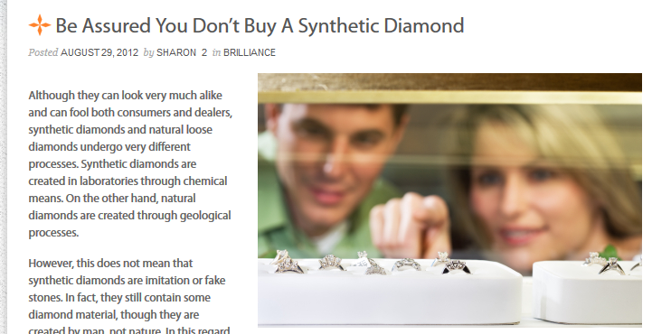

Crystals Side Note
What is the difference between synthetic and natural diamonds?

Slide 21
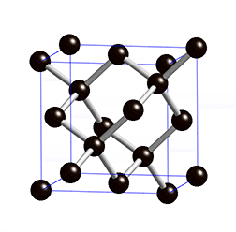
“Natural” Diamond | Synthetic Diamond Man-made Diamond Lab Created Diamond
Synthesis
Geological Pressure-Time
Anvil + Hydraulic Press
Composition
C_{n}
C_{n}
Structure
X-ray pattern
Same
Properties
Same
Size (flawless)
~20 g (100 ct)
~2 g (10 ct)
Cost
$10,000/ct
$4,000/ct
Resale (mv)
35%
35-80%
Production Staff
Slave Labor
B.S. and M.S. Chemists
and Engineers
Value added to your relationship
0

Slide 22
Solids
Crystalline solids
Exhibit a three-dimensional order.
Show diffraction pattern when irradiated with X-rays.
Amorphous solids
Exhibit a short-range order, but
are disordered over the long range.
Do not show diffraction pattern under X-ray irradiation.

Slide 23
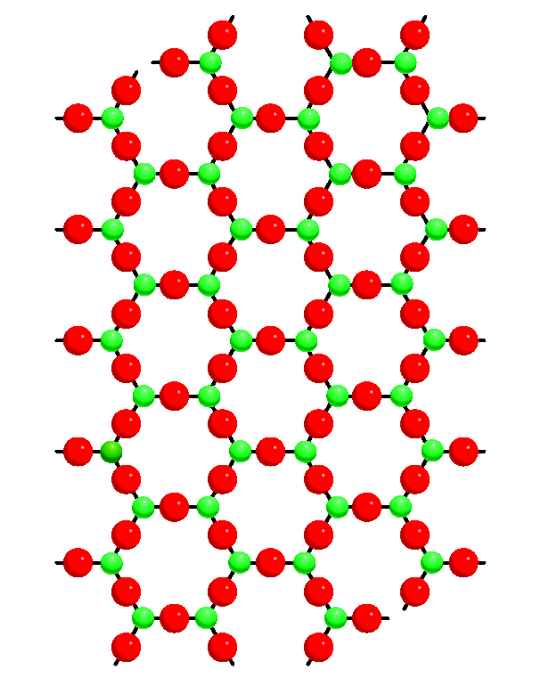
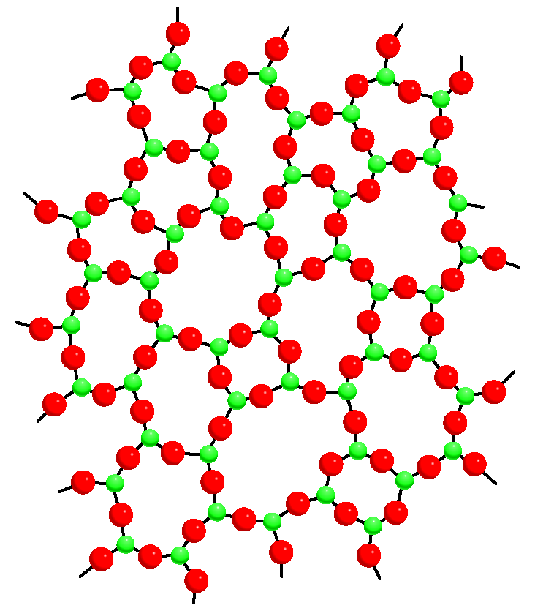
Amorphous Solids
There are many solids that are not crystalline (will not diffract)
No long range order
Molecules are arranged in a “random” manner
Flow when subject to pressure over time
Isotropic i.e. same properties in all direction
Crystalline SiO₂
(quartz)
Amorphous SiO₂
(glass)

Slide 24
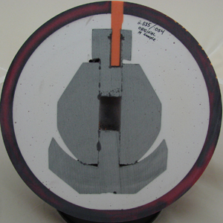
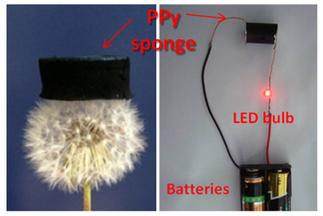
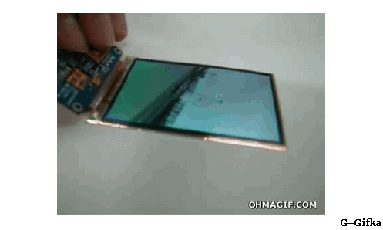
Amorphous Solid Examples
Synthetic plastics/polymers
Aerogels
Organic Electronics
Scientific Reports 2014, 4, 5792.

