Slide 1
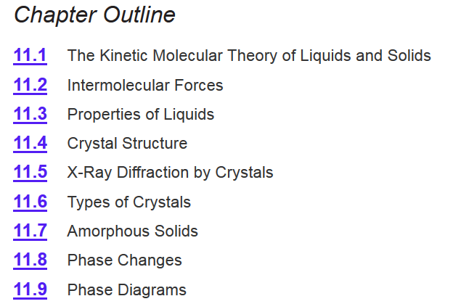

Chapter 11
Intermolecular forces according to Google Images:
Ch 11
Page 467

Slide 2
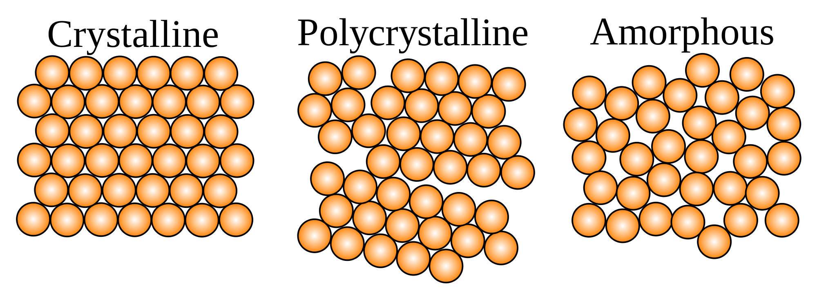
Solids
Crystalline solids
  Exhibit a three-dimensional order.
  Show diffraction pattern when irradiated with X-rays.
Amorphous solids
  Exhibit a short-range order, but
  are disordered over the long range.
  Do not show diffraction pattern under X-ray irradiation.

Slide 3
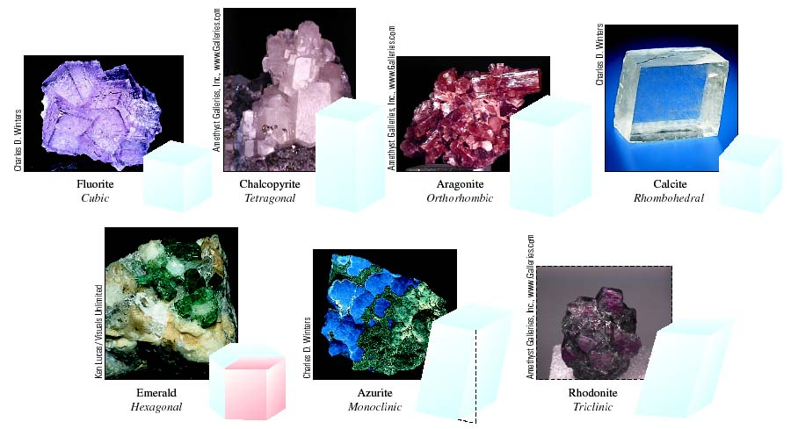
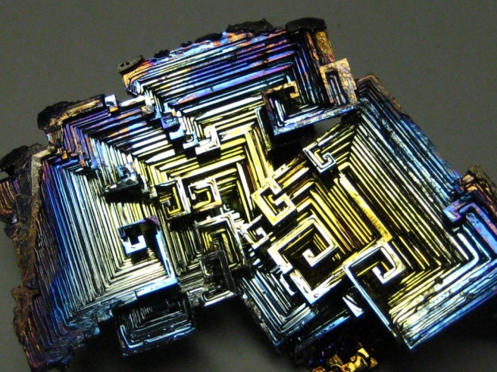
Crystalline Solids
Bismuth Crystals

Slide 4
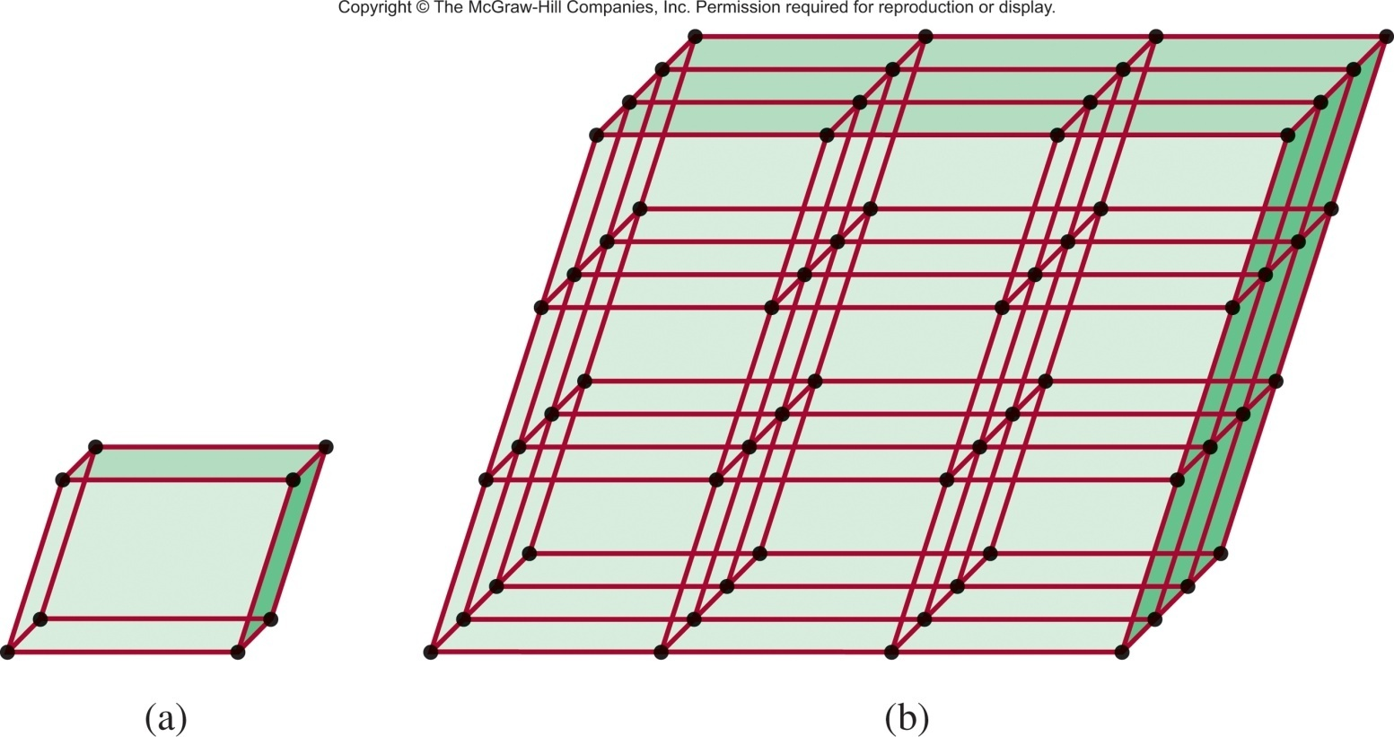
Crystalline Solids
A crystalline solid possesses rigid and long-range order. In a crystalline solid, atoms, molecules or ions occupy specific (predictable) positions.
A unit cell is the basic repeating structural unit of a crystalline solid.
lattice
point
At lattice points:
Atoms
Molecules
Unit Cell
Unit cells in 3 dimensions

Slide 5
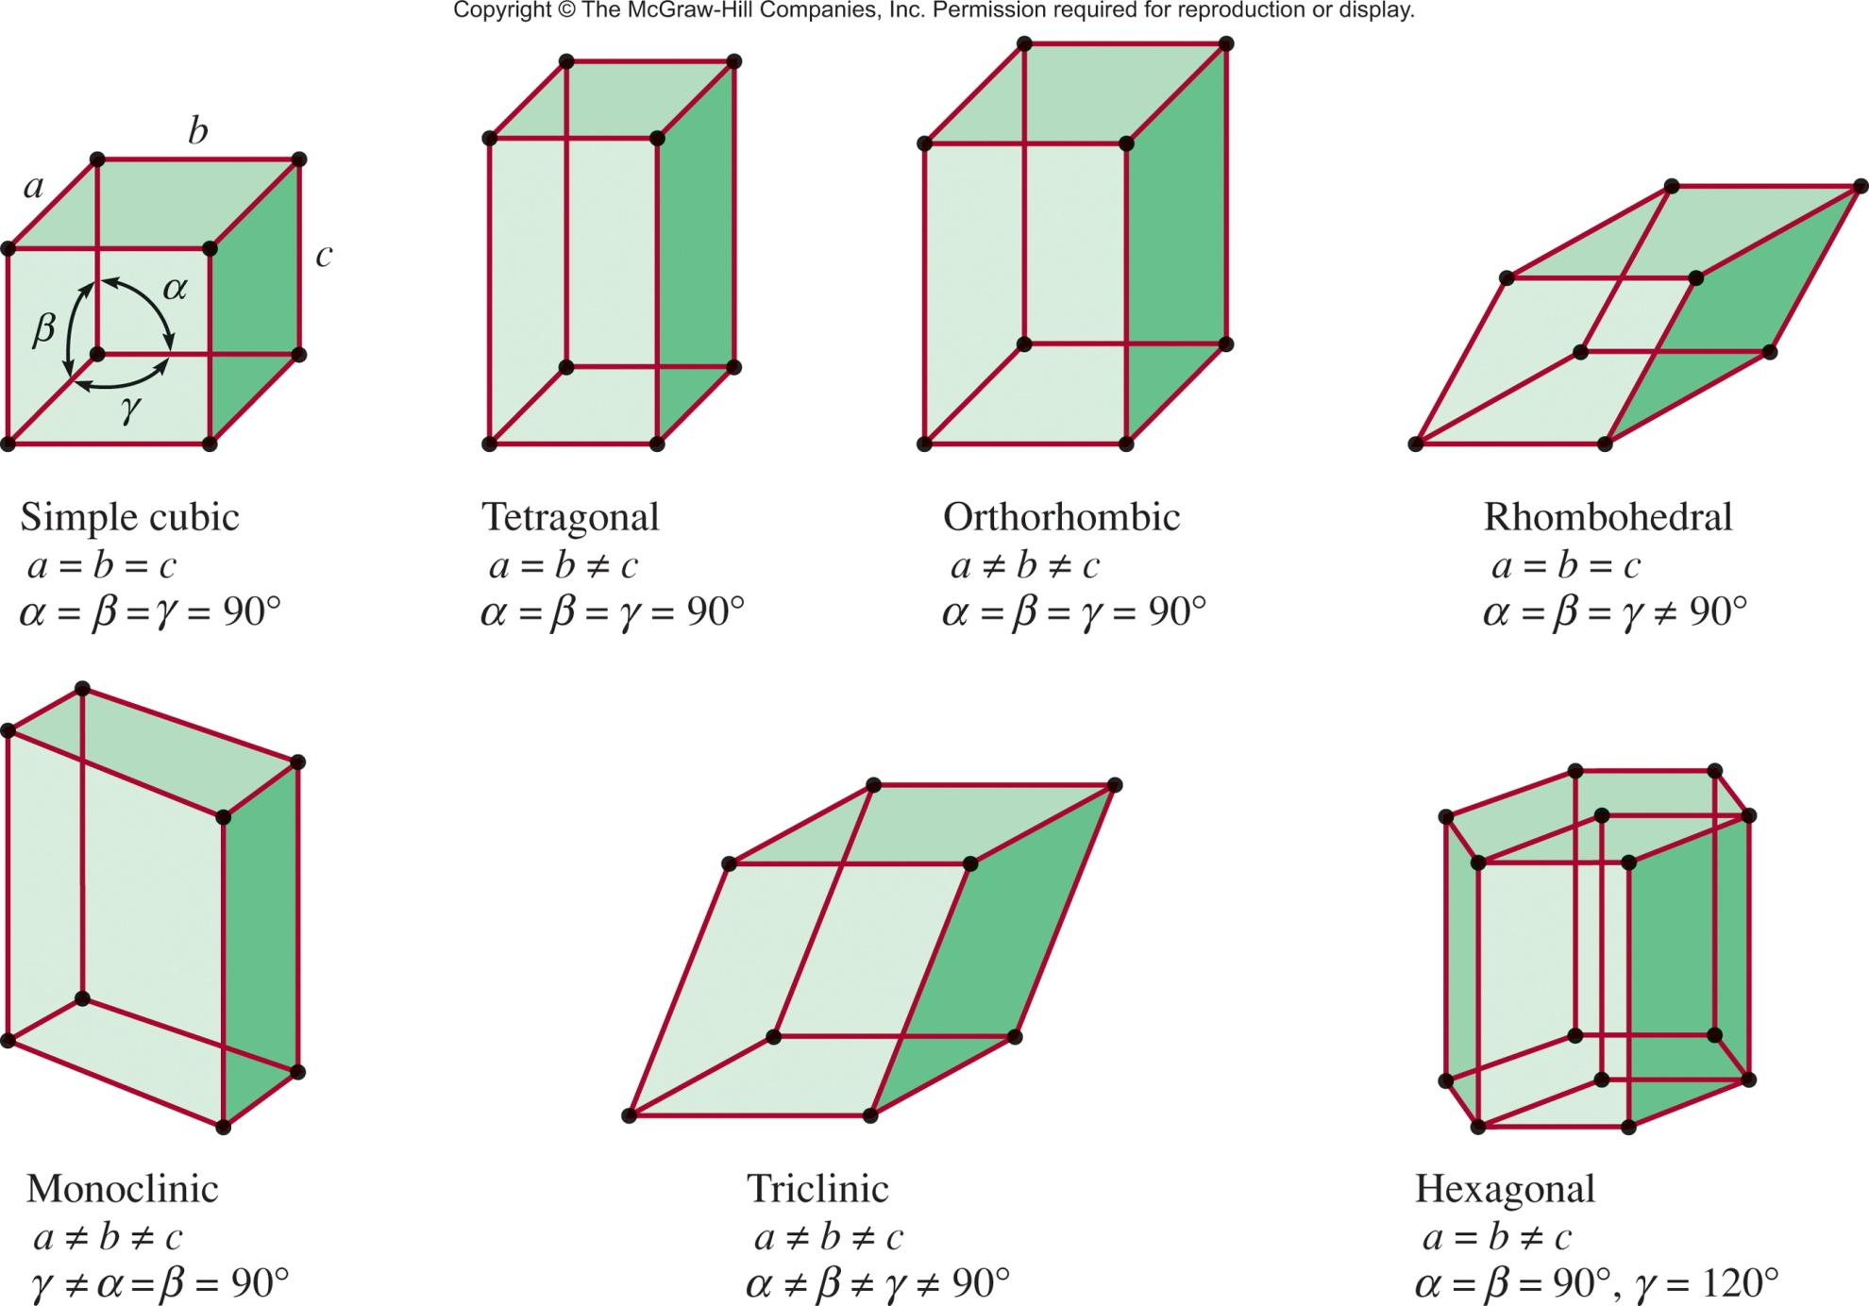
Seven Basic Unit Cells
Ch 11.4
Page 480

Slide 6
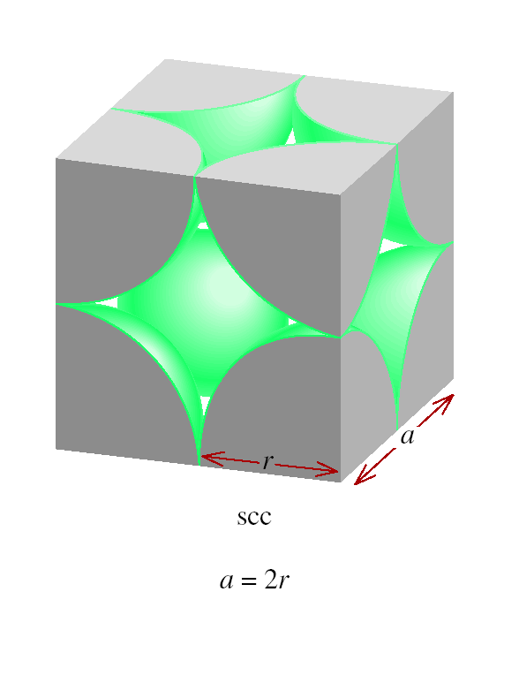
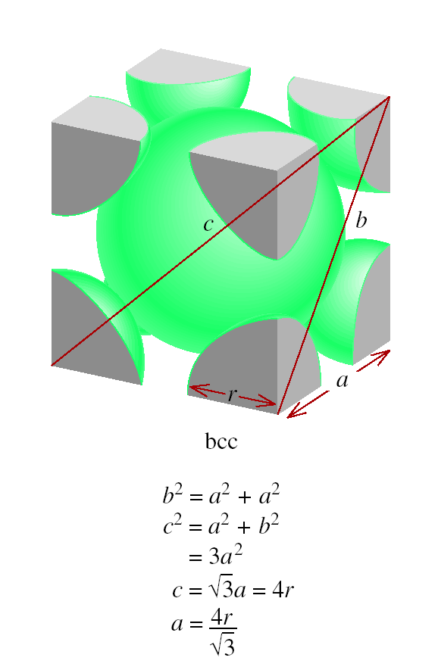
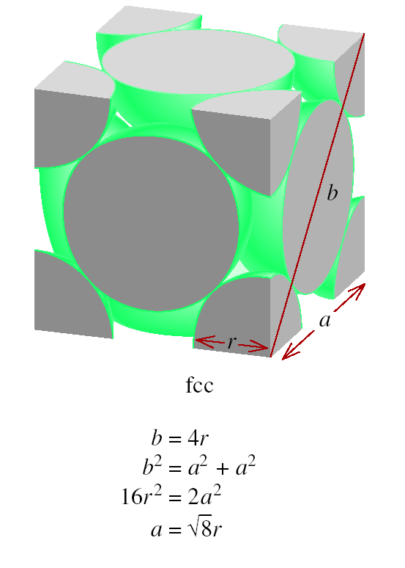
Relation Between Edge Length and Atomic Radius

Slide 7
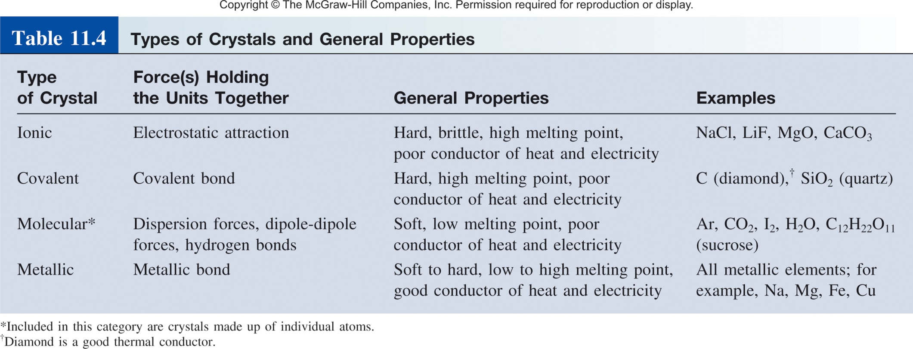
Types and Examples of Crystalline Solids
Ch 11.6
Page 493

Slide 8
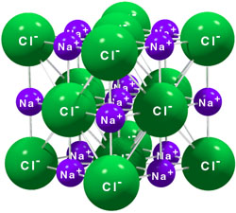
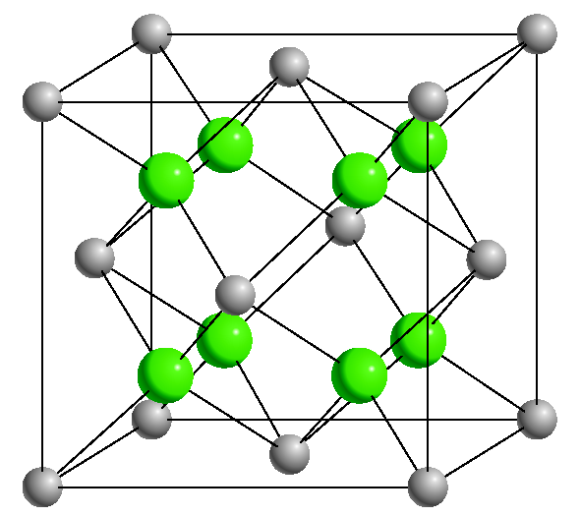
Ionic Crystals
Lattice points occupied by cations and anions
Held together by electrostatic attraction
Hard, brittle, high melting point
Poor conductor of heat and electricity
NaCl
CaF₂

Slide 9
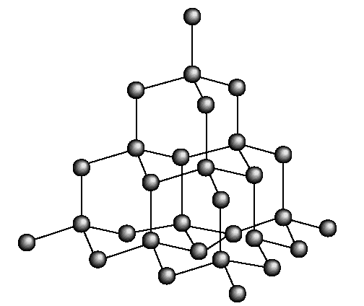
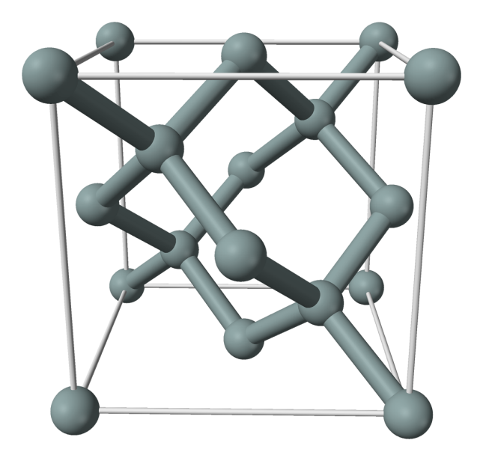
Covalent Crystals
Lattice occupied by atoms
Held together by covalent bonds
Hard, high melting point
Poor conductor of heat and electricity
carbon
atoms
silicon
atoms
diamond
silicon

Slide 10
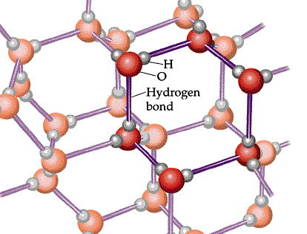
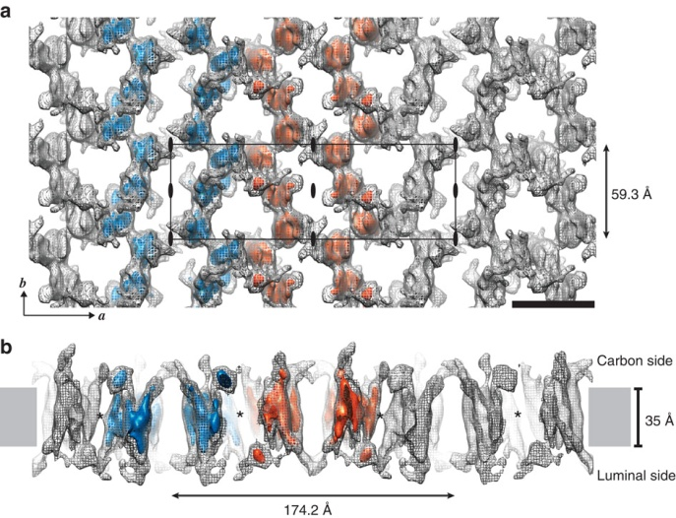
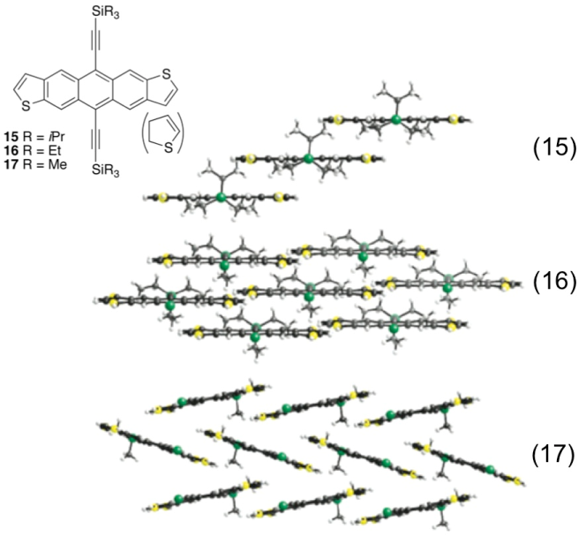
Molecular Crystals
Lattice points occupied by molecules
Held together by intermolecular forces
Soft, low melting point
Poor conductor of heat and electricity
H₂O (ice)
Proteins
Organic Molecules

Slide 11
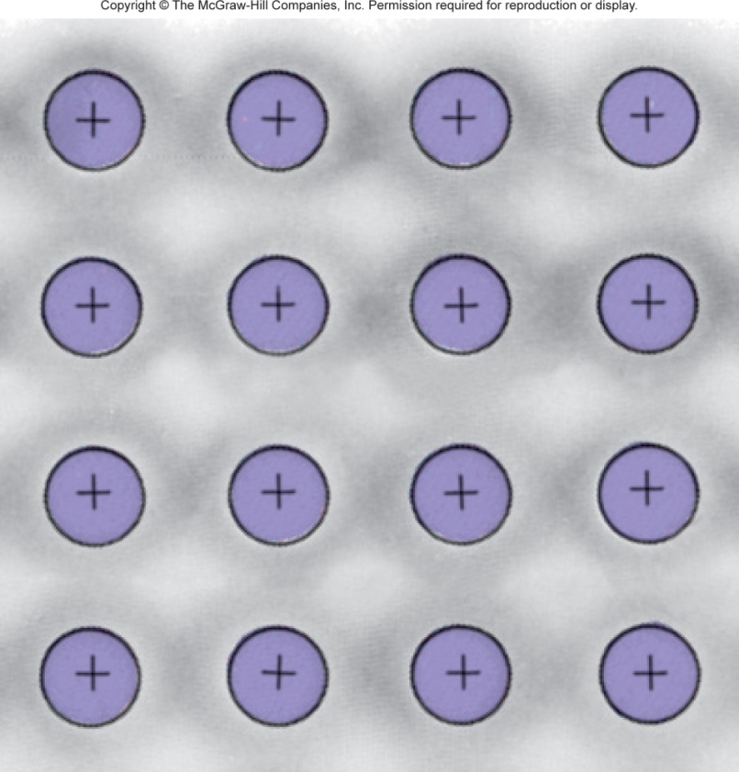
Metallic Crystals
Lattice points occupied by metal atoms
Held together by metallic bonds
Soft to hard, low to high melting point
Good conductors of heat and electricity
Cross Section of a Metallic Crystal
nucleus &
inner shell e⁻
mobile “sea”
of e⁻

Slide 12
Types and Examples of Crystalline Solids
Atomic solids
  Only the noble gases
Molecular solids
  H₂, Cl₂, H₂O, CH₄, C₆H₁₂O₆ (glucose)
Ionic solids
  NaCl, CaF₂
Network covalent solids
  C (diamond), C (graphite), SiO₂ (quartz)
Metallic solids
  Na, Ca, Fe, Cu, Pb, Gd

Slide 13
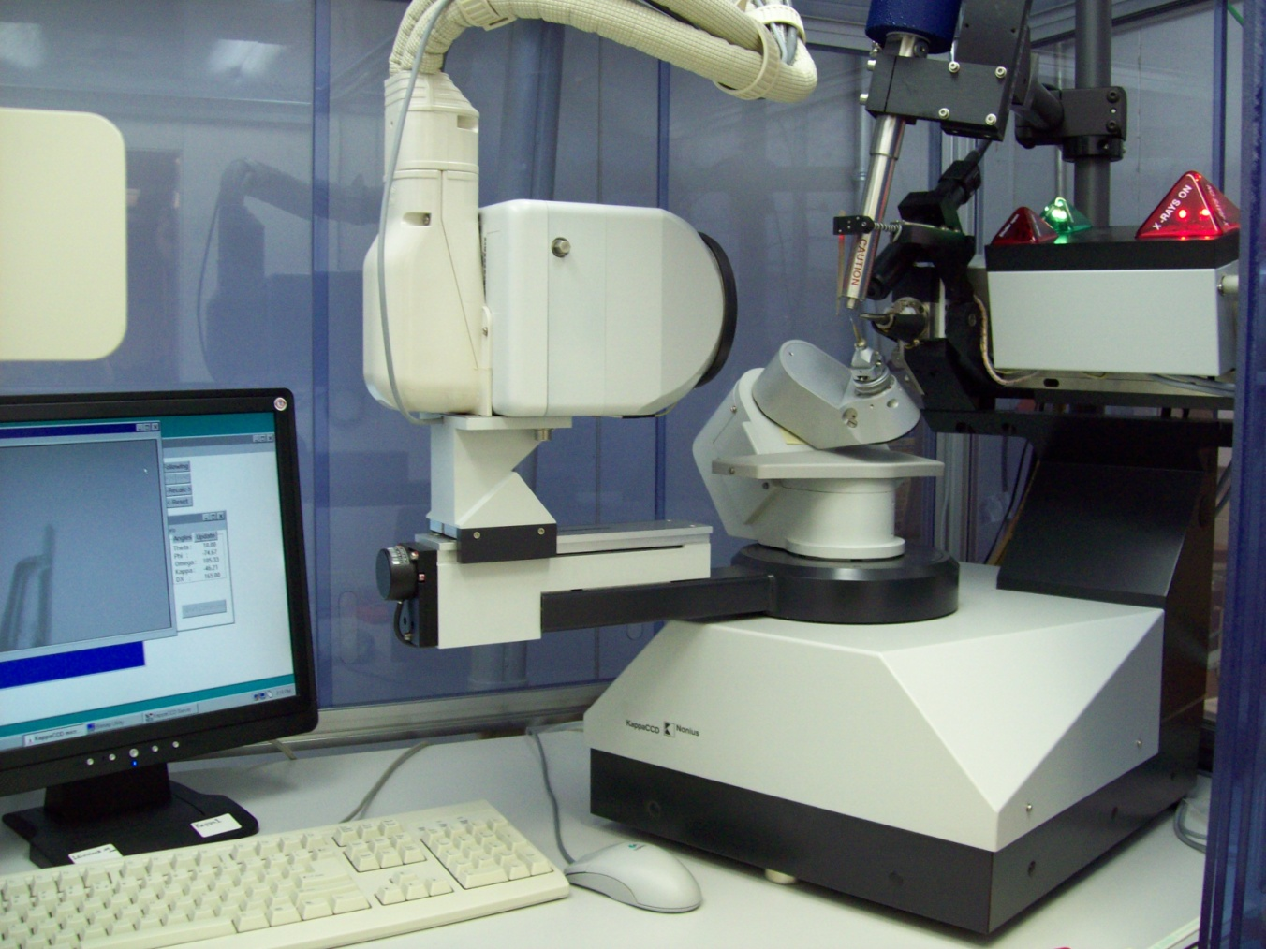
How do we know their structure?
x-ray crystallography
Ch 11.5
Page 486

Slide 14
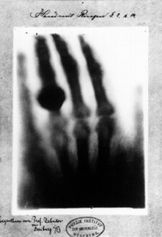
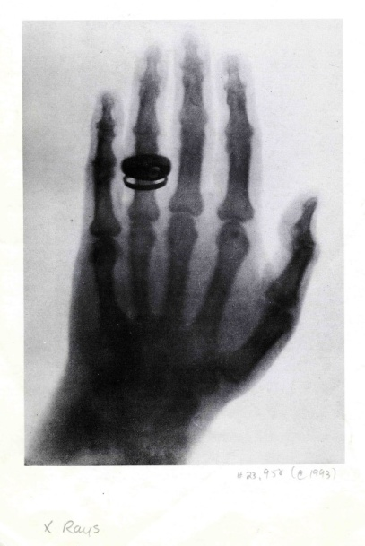
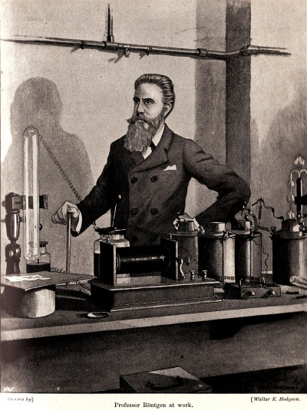
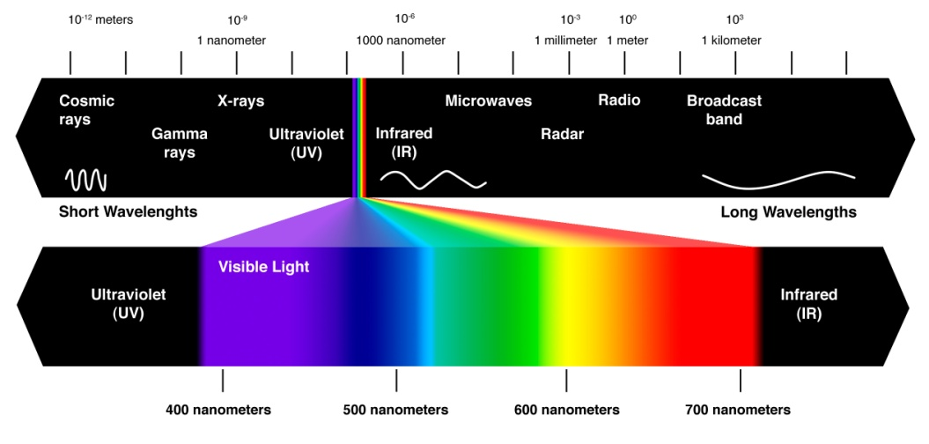
Discovery of X-Rays
The first Nobel prize in Physics
Wilhelm Röntgen (1901)

Slide 15
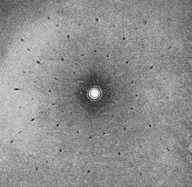
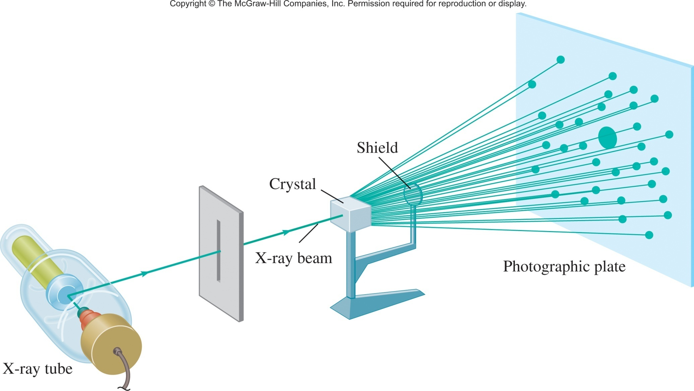
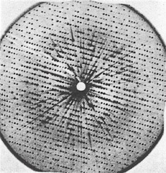
X-Rays Diffraction
NaCl
X-ray Diffraction
Myoglobin

Slide 16
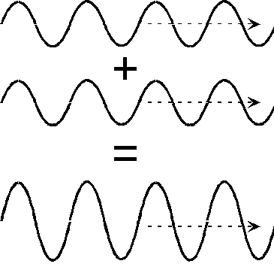
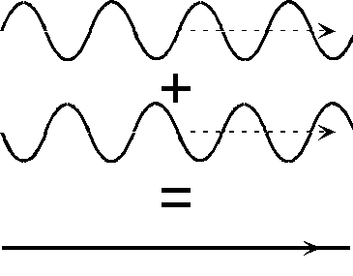
x-ray Diffraction
NaCl
destructively
constructively

Slide 17
Diffraction
Can be observed for any kind of waves
When diffraction occurs from several periodically arranged objects, the waves add up (interference) to produce maxima and minima of intensity
To achieve this effect, the distance between the objects should be comparable to the wavelength
In crystals, interatomic distances are on the order of 10⁻¹⁰ m = 1 Å
Hence, the X-rays!

Slide 18
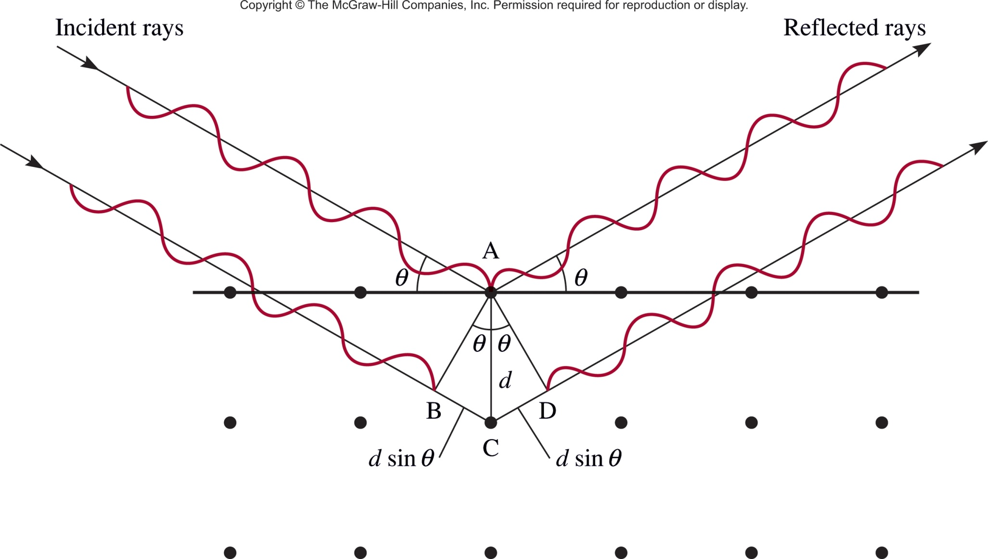

X-Ray Diffraction
Constructive Interference
Will only be constructive (give a spot) if:
the length of (B to C + C to D)
=
[ ]
n
Ch 11.5
Page 486

Slide 19
Example Calculation
X rays of wavelength 0.154 nm strike an aluminum crystal; the rays are reflected at an angle of 19.3°.
Assuming that n = 1, calculate the spacing between the planes of aluminum atoms in pm that is responsible for this angle of reflection.
The conversion factor is obtained from 1 nm = 1000 pm.

Slide 20
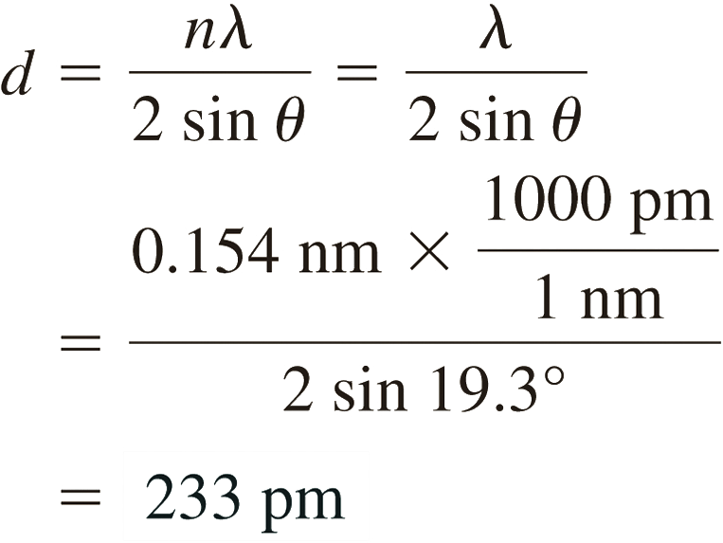
Example Calculation
Solution Converting the wavelength to picometers and using the angle of reflection (19.3°), we write

Slide 21
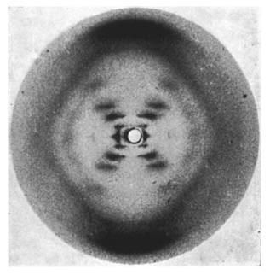
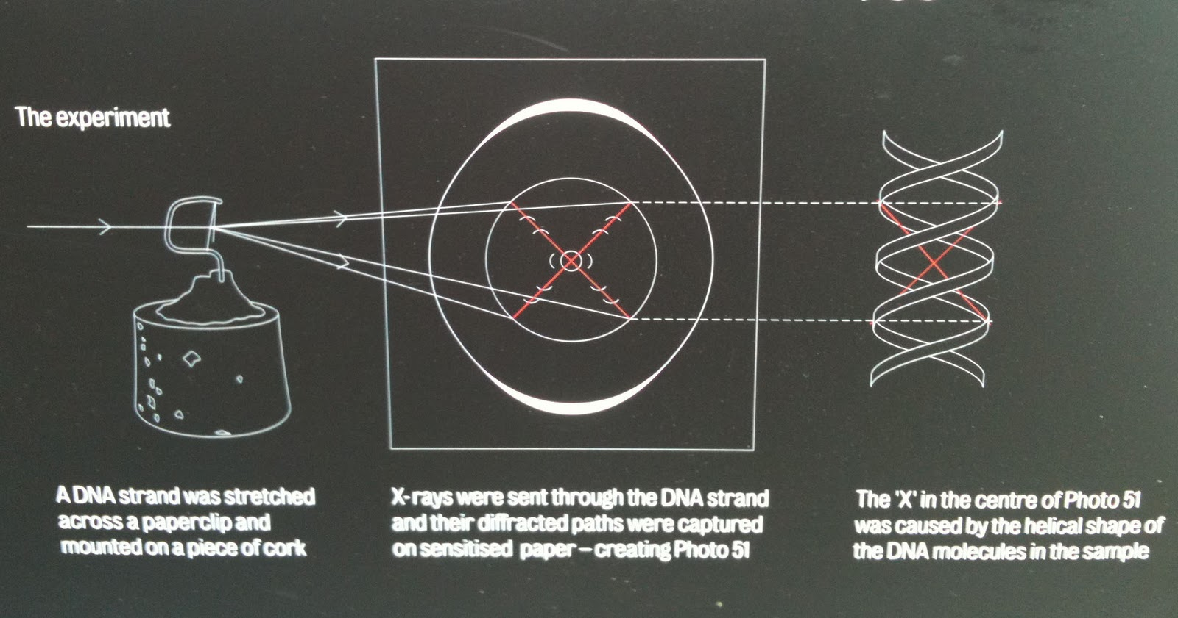
Diffraction
Photo 51
Rosalind Franklin

Slide 22
X-Ray Crystallography

Slide 23
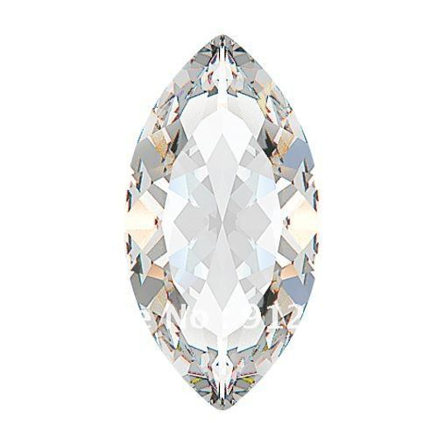
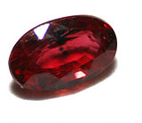
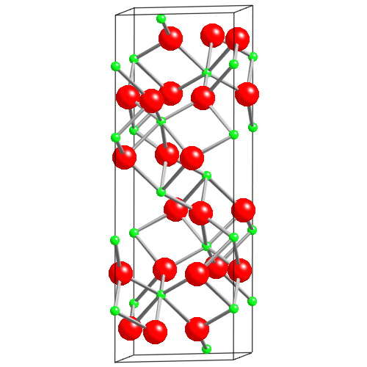
Crystals Side Note
Al₂O₃
Ruby
Replace
1% Al³⁺ with Cr³⁺
Colorless
Absorbs yellow-green
Emits red
Al green
O red
Most expensive ruby (1.6 cm³) = $6.7 million
Al₂O₃ (1.5 cm³) = ~$500

Slide 24
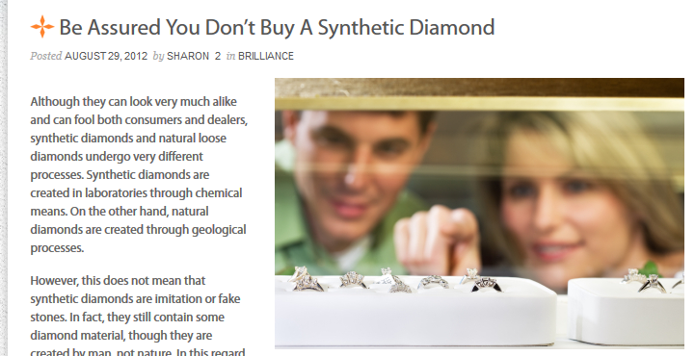

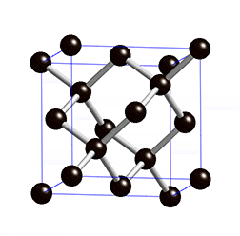
Crystals Side Note
“Natural” Diamond
Synthetic Diamond
Man-made Diamond
Lab Created Diamond

Slide 25
Solids
Crystalline solids
  Exhibit a three-dimensional order.
  Show diffraction pattern when irradiated with X-rays.
Amorphous solids
  Exhibit a short-range order, but
  are disordered over the long range.
  Do not show diffraction pattern under X-ray irradiation.

Slide 26
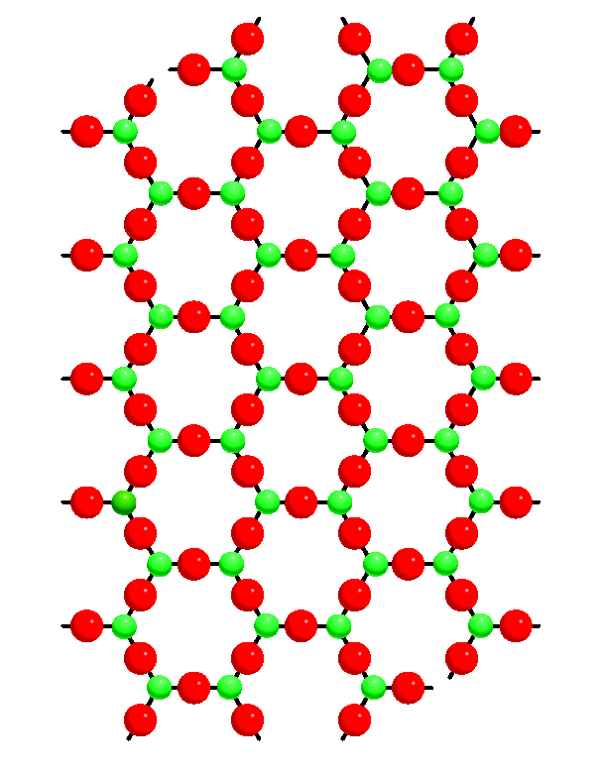
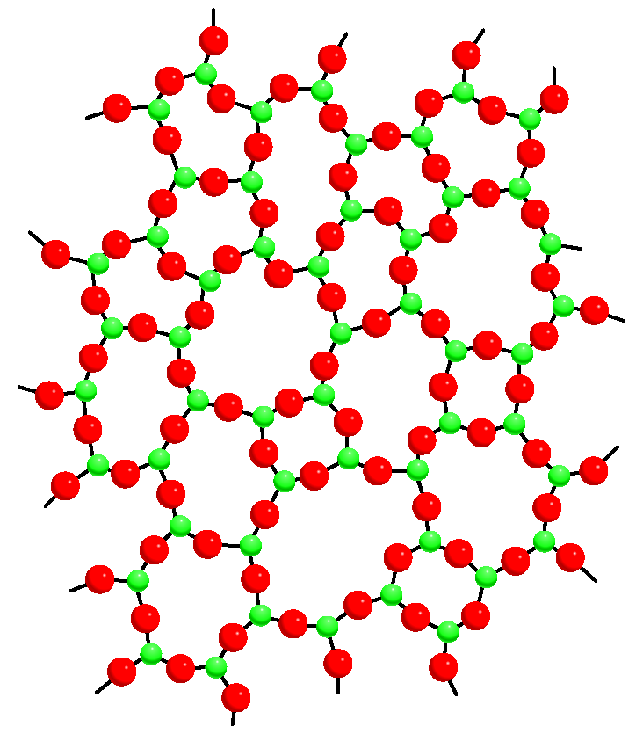
Amorphous Solids
There are many solids that are not crystalline (will not diffract)
No long range order
Molecules are arranged in a “random” manner
Flow when subject to pressure over time
Isotropic i.e. same properties in all direction
Crystalline SiO₂
(quartz)
Amorphous SiO₂
(glass)
Ch 11.7
Page 494

Slide 27
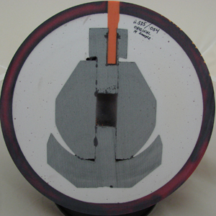
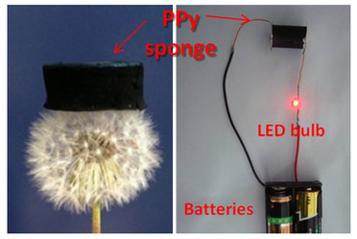
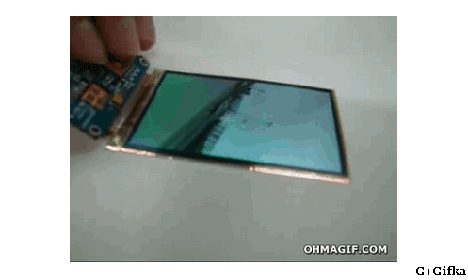
Amorphous Solid Examples
Synthetic plastics/polymers
Aerogels
Organic Electronics
Scientific Reports 2014, 4, 5792.

Slide 28
Chapter 11
Intermolecular forces according to Google Images:
Ch 11
Page 467

