Slide 1
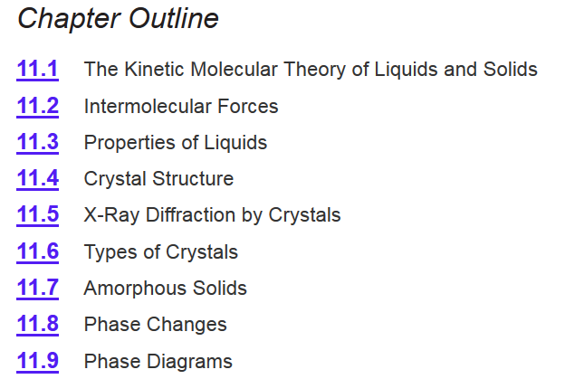
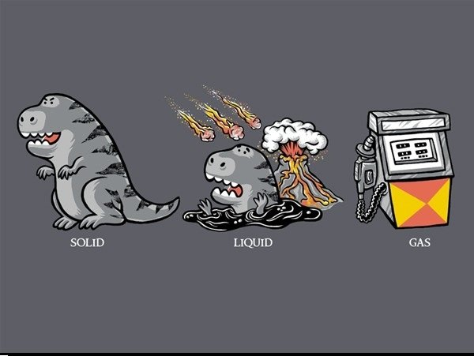
Chapter 11
Ch 11
Page 467

Slide 2
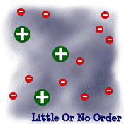



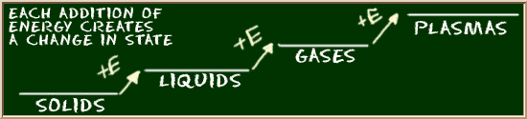
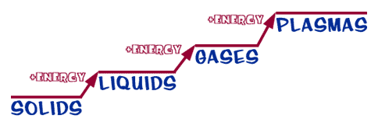
STATES OF MATTER
CH 11.4-7
CH 11.1-3
CH 5
The internet?
Phase Change-
The transformation from one phase to another upon the addition or release of energy.
Temperature does not change during a phase change.

Slide 3
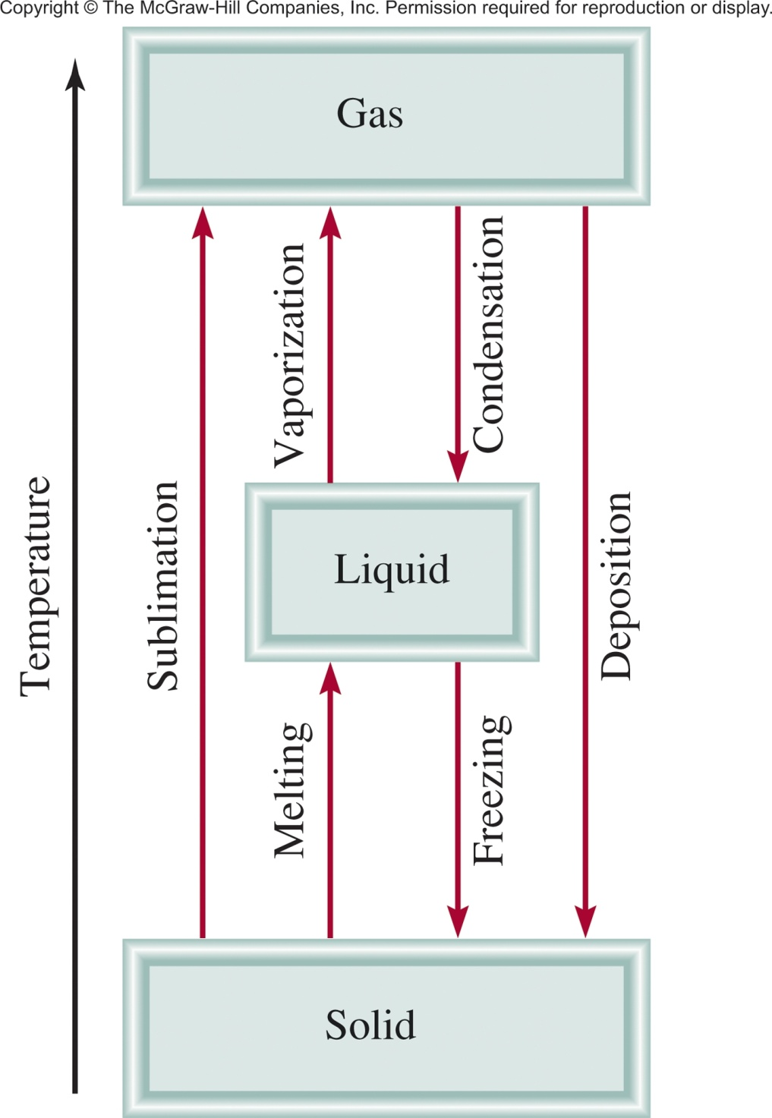
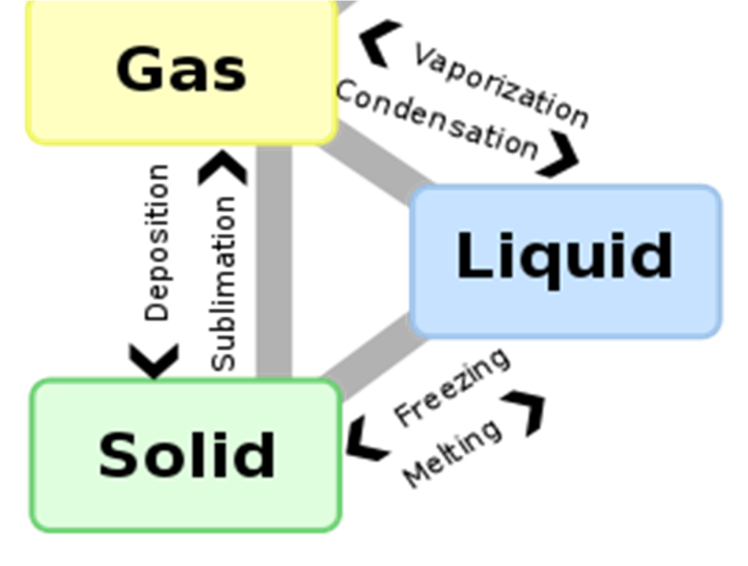
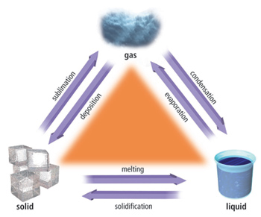
Phase Changes
Least
Order
Most
Order
Ch 11.8
Page 495

Slide 4
Phase Changes
Least
Order
Outline
Liquid ↔ Gas (p 496-501)
Solid ↔ Liquid (p 501-503)
Solid ↔ Gas (p 504-505)
Most
Order

Slide 5
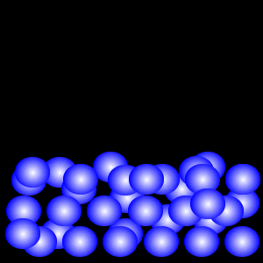

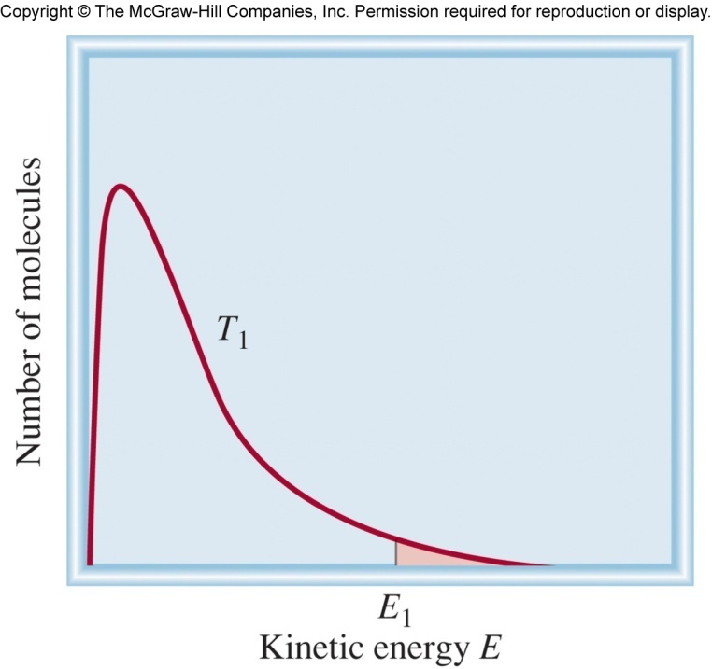
Liquid ↔ Gas
Kinetic energy of molecules.
“slow” molecules
“fast” molecules
Some molecules are fast enough to escape intermolecular forces.

Slide 6

Liquid ↔ Gas
Liquid
At time = 0
At time > 0
At time = ∞
At equilibrium!
# of molecules in =
# of molecules out
rate of evaporation =
rate of condensation

Slide 7
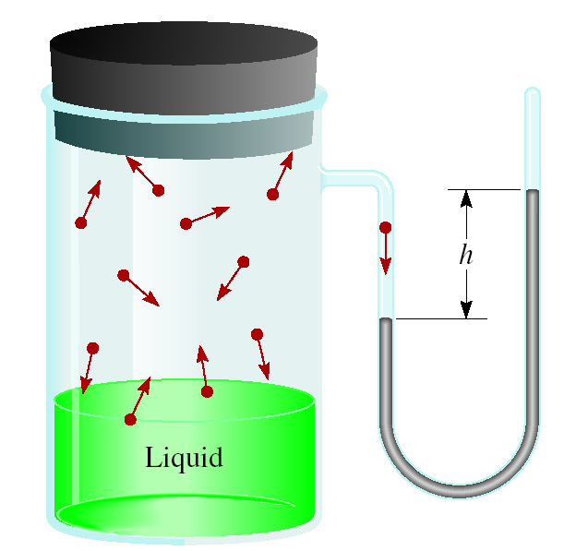
Liquid ↔ Gas
Molecular motion causes force.
Force creates pressure.
We can measure the pressure.
Vapor pressure (VP)- is the pressure exerted by a vapor in equilibrium with its condensed phases (solid or liquid) at a given temperature in a closed system.
# of molecules in =
# of molecules out
rate of evaporation =
rate of condensation
At a given temperature:
  Weaker intermolecular forces =
  more molecules out =
  higher vapor pressure
  Vapor pressure is temperature dependent!

Slide 8

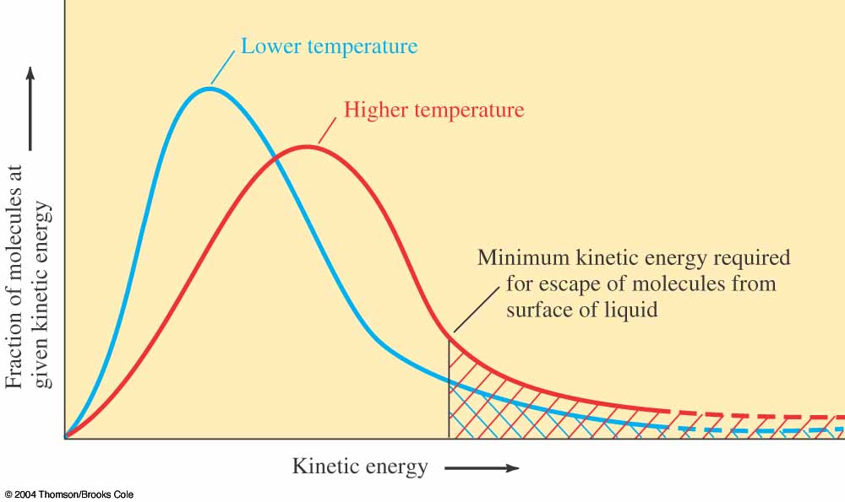
Liquid ↔ Gas
  Vapor pressure is temperature dependent!
Lower T =
Lower P
Higher temperature (T) =
higher average kinetic energy =
more molecules escaping solution =
higher vapor pressure (P)
Higher T =
Higher P
Ch 11.8
Page 496

Slide 9
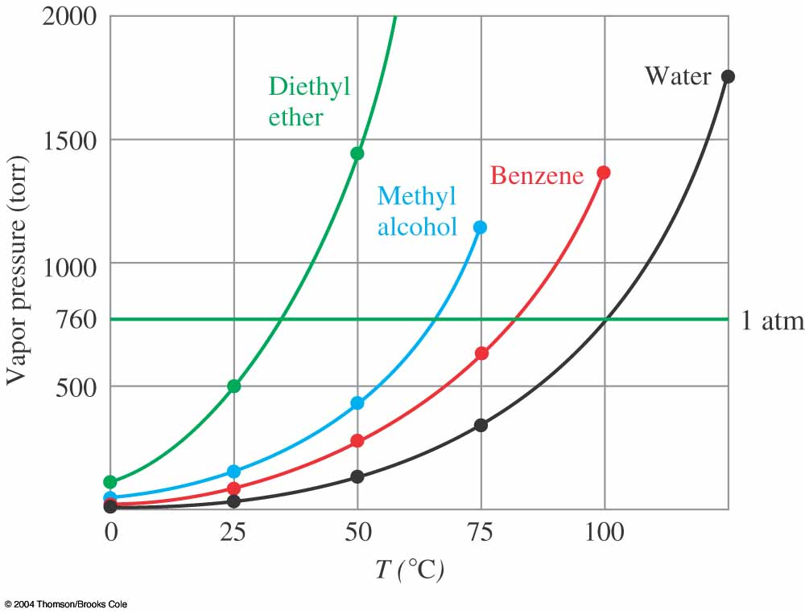
Relationship Between T and P
The experiment-
Close container with pressure gauge.
Filled with liquid.
Increase temperature and measure pressure.
Graph pressure vs. temperature.
Hot Plate
Each point on the line is the boiling point at that pressure.
Ch 11.8
Page 497

Slide 10
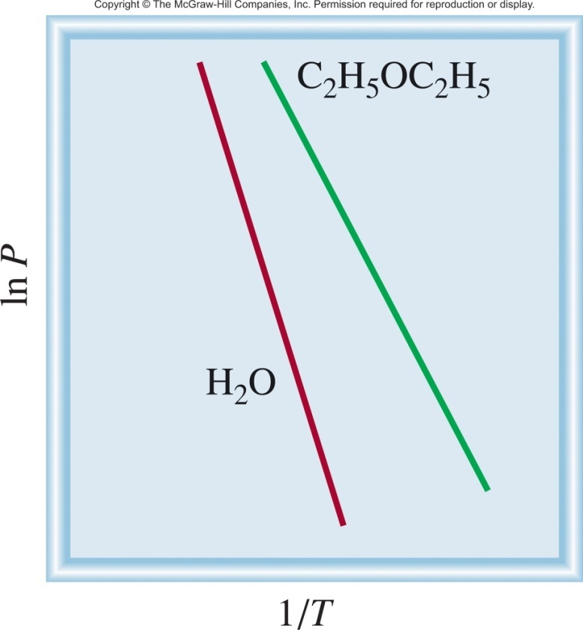
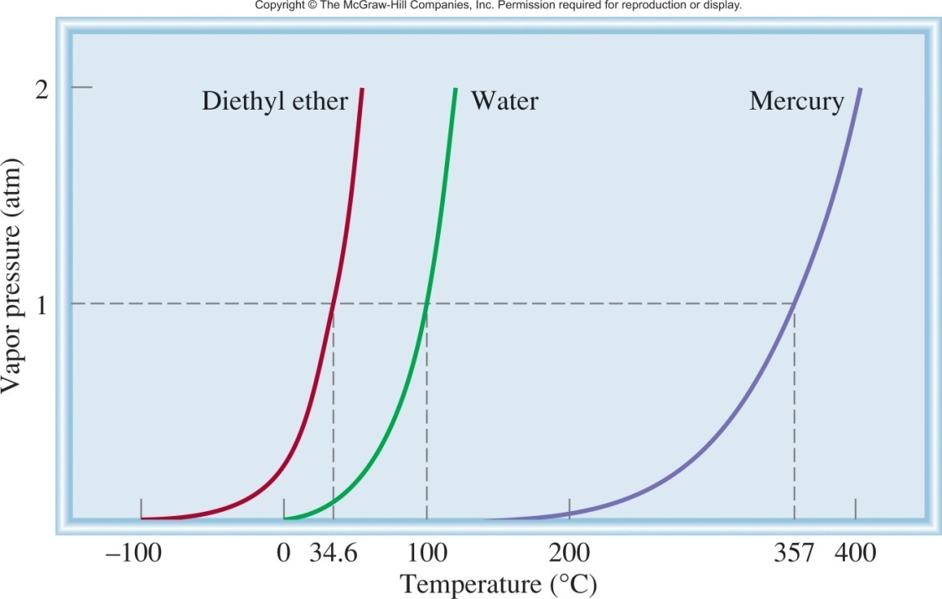
Relationship Between T and P
P = vapor pressure (atm)
y = m • x + b
T = temperature (K)
ΔH_{vap}
1
R = gas constant (8.314 J/K•mol)
ln P =
-
•
+ C
ΔH_{vap} = molar heat of vaporization (J/mol)
R
T
Ch 11.8
Page 498
Clausius-Clapeyron Equation

Slide 11
Relationship Between T and P
Clausius-Clapeyron Equation
ΔH_{vap}
1
ln P =
-
•
+ C
R
T
P = vapor pressure (atm)
T = temperature (K)
R = gas constant (8.314 J/K•mol)
ΔH_{vap} = molar heat of vaporization (J/mol)
Molar heat of vaporization (ΔH_{vap}) is the energy required to vaporize 1 mole of a liquid at its boiling point.
Dependent on the substance and its intermolecular forces.
more intermolecular force = larger ΔH_{vap}
Independent of temperature.

Slide 12
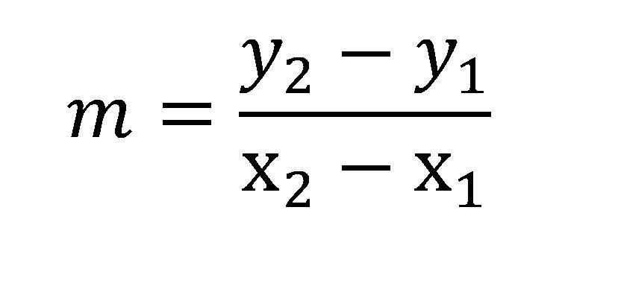
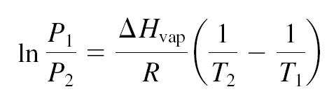
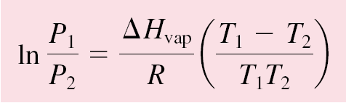
Relationship Between T and P
Alternate Forms of the Clausius-Clapeyron Equation
Slope = change in y/the change in x
or
If we know ΔH_{vap}, P and T at one temperature we can predict P at another T.
Ch 11.8
Page 499
or T (bp) at another P.

Slide 13
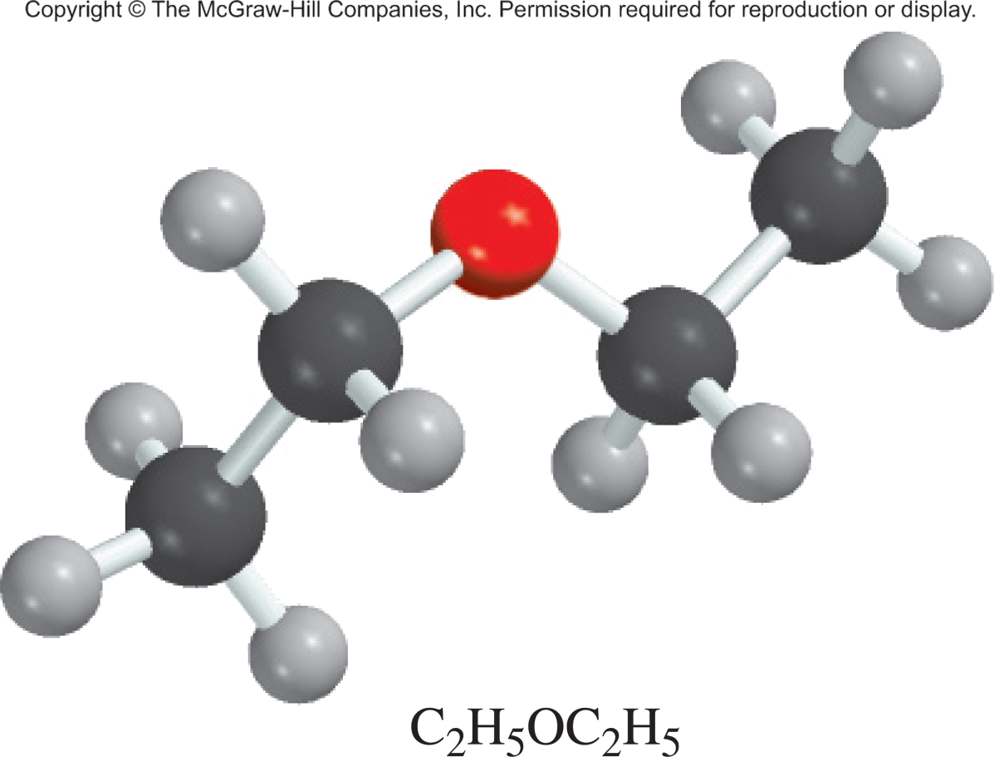
11.7
Diethyl ether is a volatile, highly flammable organic liquid that is used mainly as a solvent.
The vapor pressure of diethyl ether is 401 mmHg at 18°C and the ΔH_{vap} = 26.0 kJ/mol. Calculate its vapor pressure at 32°C.
P = vapor pressure (atm)
T = temperature (K)
R = gas constant (8.314 J/K•mol)
ΔH_{vap} = molar heat of vaporization (J/mol)

Slide 14
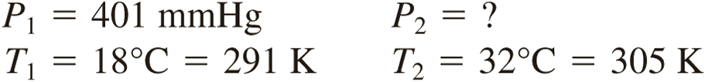
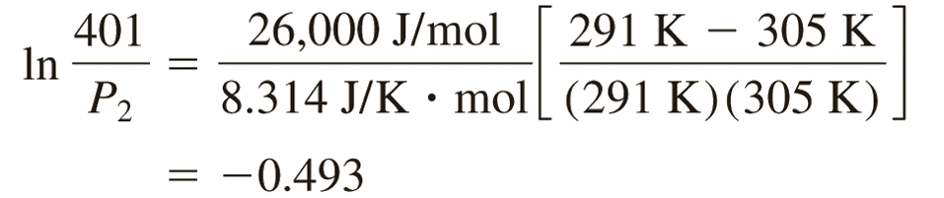
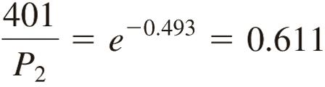
11.7
Solution Table 11.6 tells us that ΔH_{vap} = 26.0 kJ/mol. The data are
From Equation (11.5) we have
Taking the antilog of both sides (see Appendix 4), we obtain
P₂ = 656 mmHg
Check We expect the vapor pressure to be greater at the higher temperature. Therefore, the answer is reasonable.

Slide 15
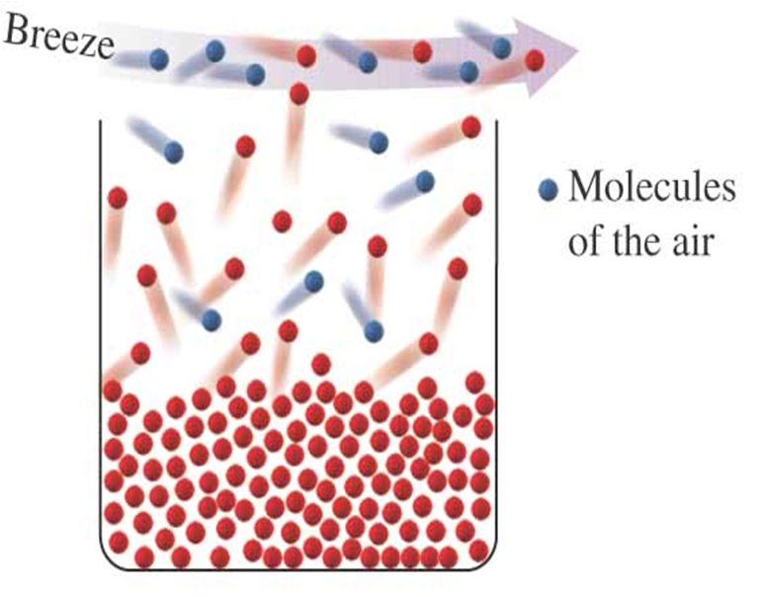
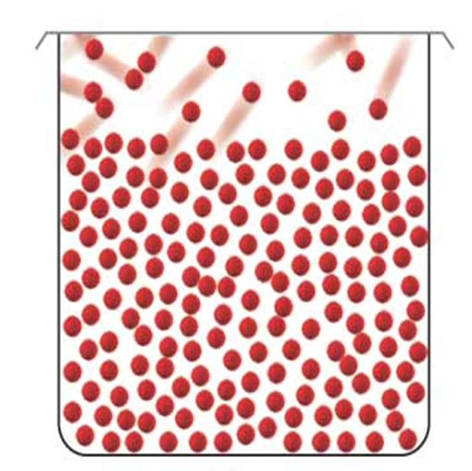
Closed vs. Open Systems
Closed System
Open System
at equilibrium
not at equilibrium
liquid molecules lost
has a Boiling Point

Slide 16
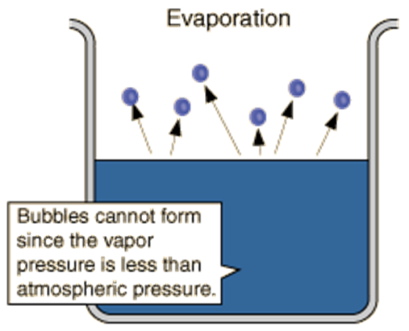
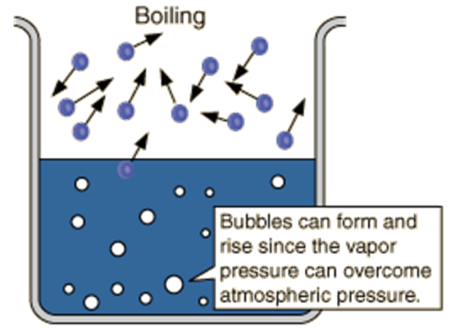
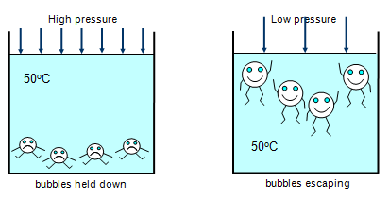
Boiling Point
External pressure
External pressure
Vapor pressure
Vapor pressure
Lower Temp
Higher Temp
vapor pressure < external pressure
vapor pressure > external pressure

Slide 17
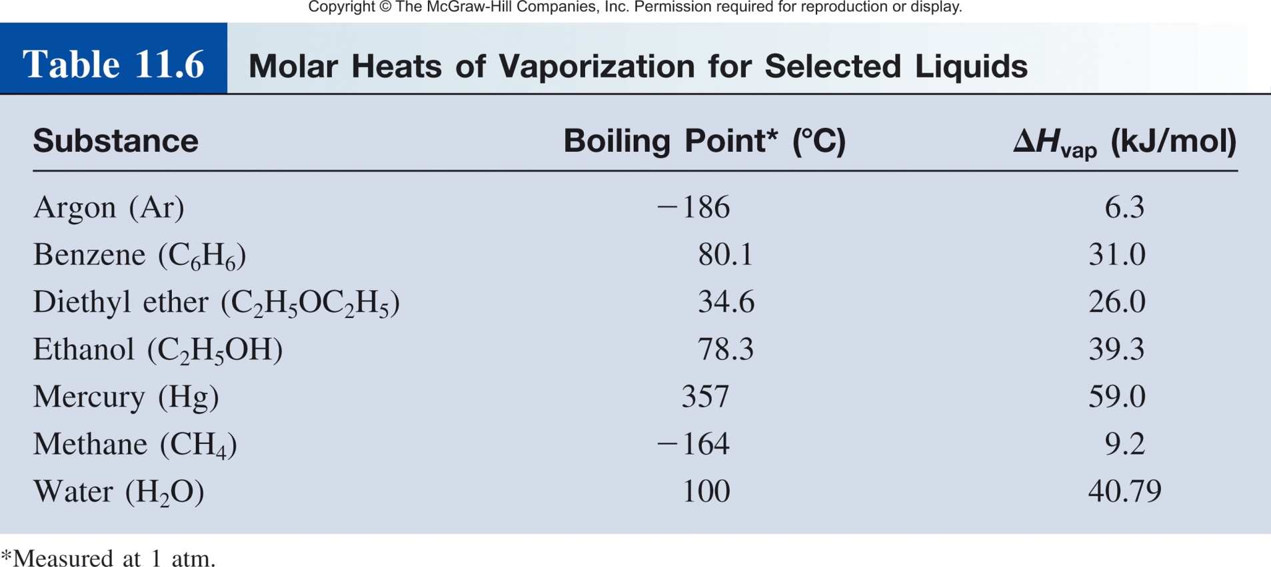
Vapor Pressure and Boiling Point
The boiling point is the temperature at which the liquid’s vapor pressure is equal to the applied external pressure.
The normal boiling point is the boiling point when the pressure is exactly 1 atm.
Decreasing the applied external pressure results in a lower boiling point.

Slide 18
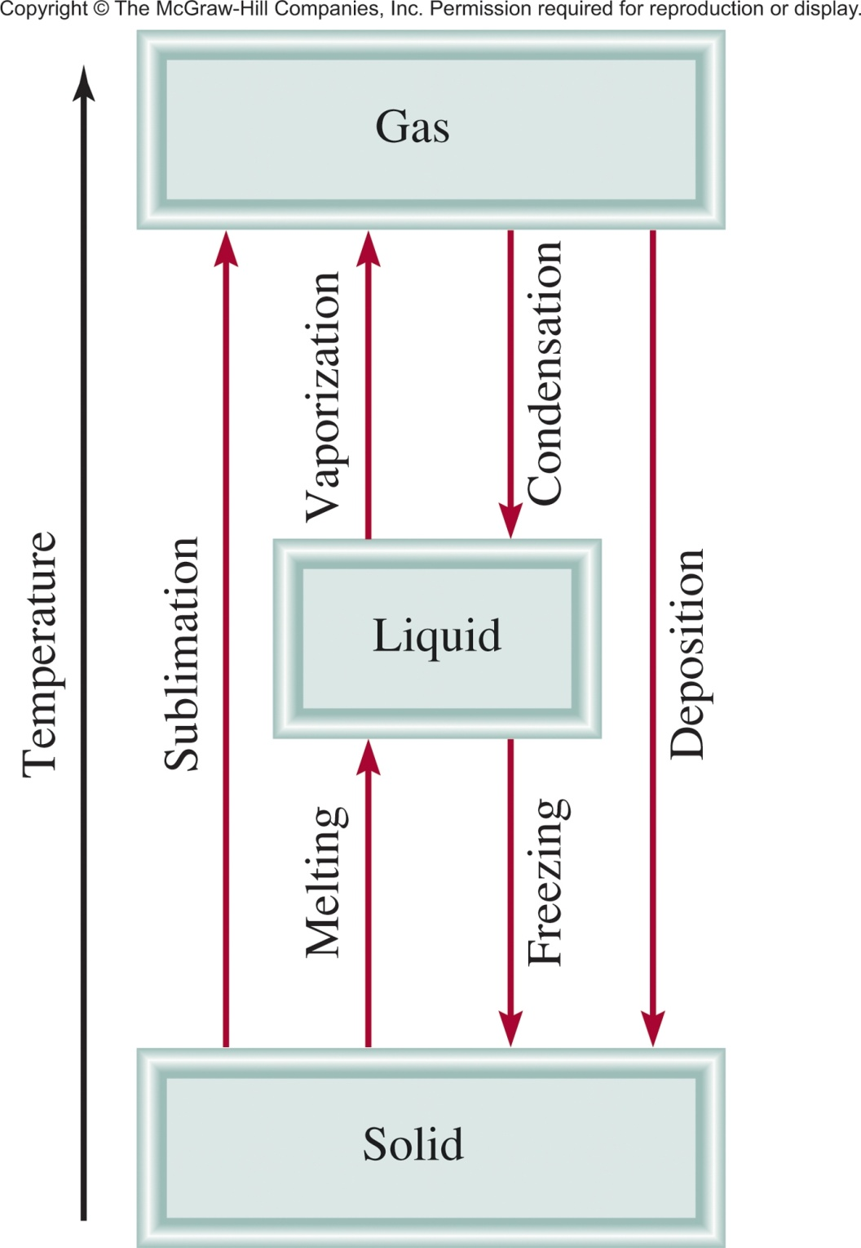
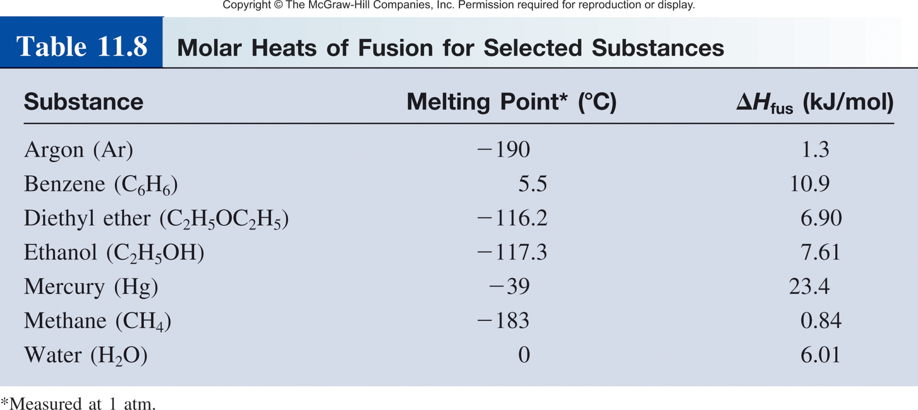
Solid ↔ Liquid
Molar heat of vaporization (ΔH_{vap}) is the energy required to vaporize 1 mole of liquid to gas.
Molar heat of fusion (ΔH_{fus}) is the energy required to melt 1 mole of solid.
Ch 11.8
Page 501

Slide 19
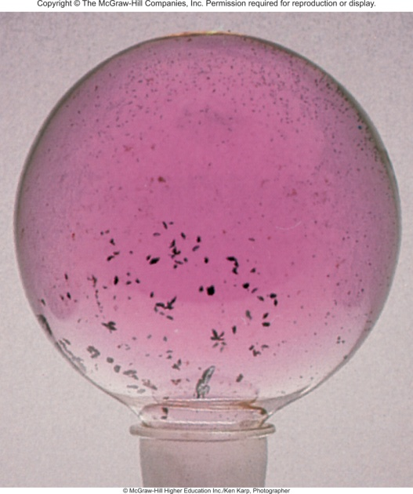

Solid ↔ Gas
Sublimation is the direct transition from the solid to the vapor state “bypassing” the liquid phase
During sublimation the solid and gas phases are in equilibrium
Iodine (I₂)
Ice Cubes
Ch 11.8
Page 504

Slide 20
Solid ↔ Gas
Molar heat of vaporization (ΔH_{vap}) is the energy required to vaporize 1 mole of liquid to gas.
Molar heat of fusion (ΔH_{fus}) is the energy required to melt 1 mole of solid.
Molar heat of sublimation (ΔH_{sub}) is the energy required to sublime 1 mole of a solid.
ΔH_{sub =} ΔH_{fus} + ΔH_{vap}
( Hess’s Law)

Slide 21
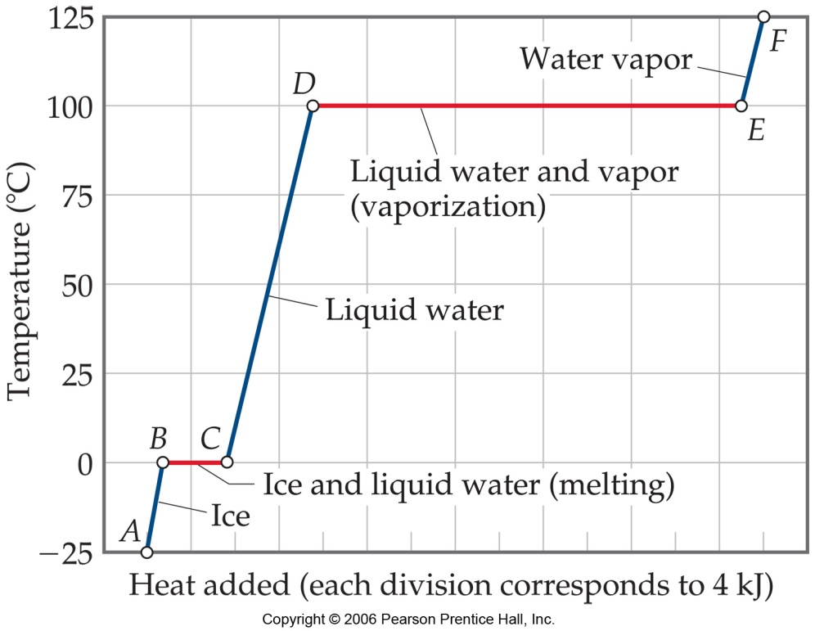
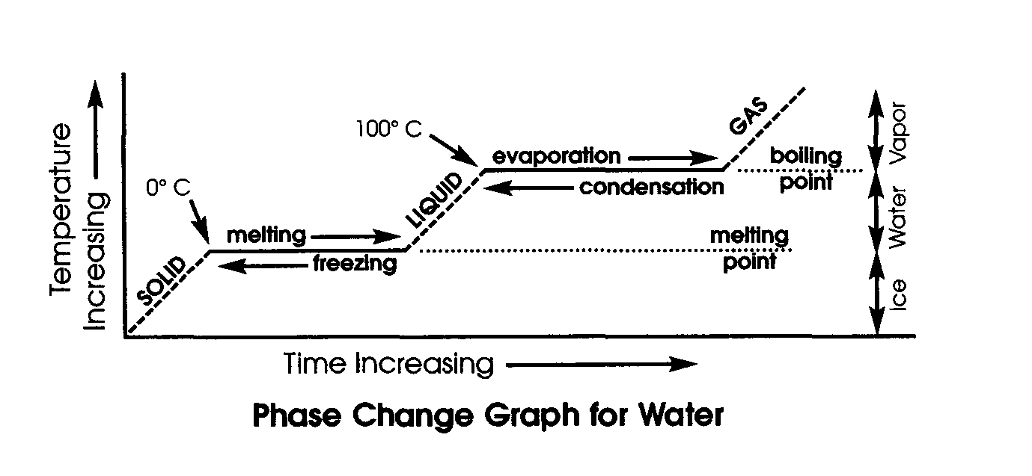
Phase Change and Heating Curve
Temperature vs. Heat added curve.
The temperature of the substance does not rise during the phase change.
The heat added to the system at the melting and boiling points goes into breaking intermolecular forces.
Ch 11.8
Page 503

Slide 22
Chapter 11
Ch 11
Page 467

Slide 23
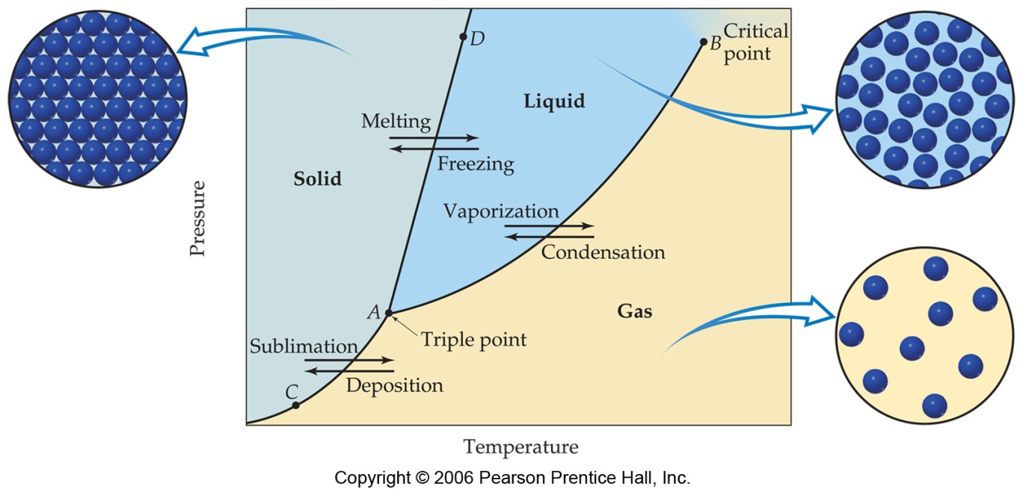
Phase Diagram
A phase diagram summarizes the conditions at which a substance exists as a solid, liquid, or gas and the places where equilibria exist between phases.
Ch 11.9
Page 505

Slide 24
Phase Diagram
Important Notes:
Each line (AC, AB, and AD): two phases are in equilibrium.
B) The critical point: above this critical temperature and critical pressure the liquid and vapor are indistinguishable from each other.
Below A: the point below which the substance cannot exist as a liquid .
A) The triple point: the point at which all three states are in equilibrium.

Slide 25
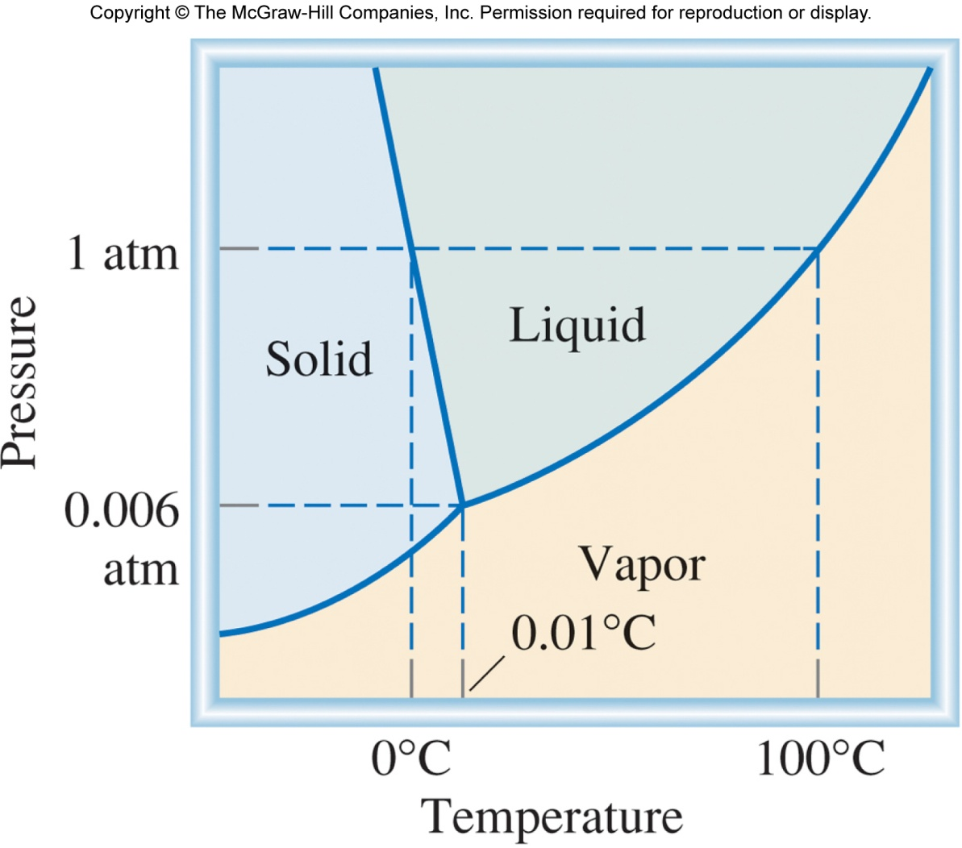
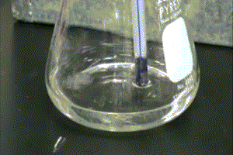

Phase Diagram of Water
Normal melting and boiling points.
Triple Point (0.006 atm and 0.01 °C)
Solid to liquid with applied pressure.

Slide 26
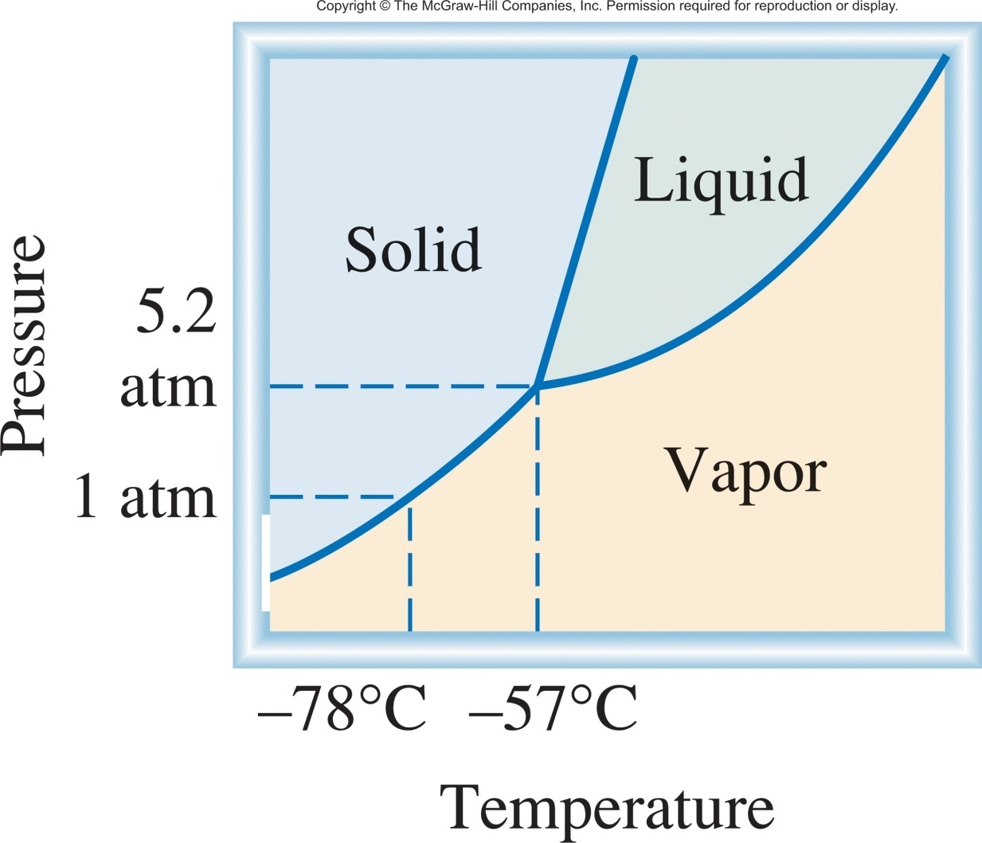
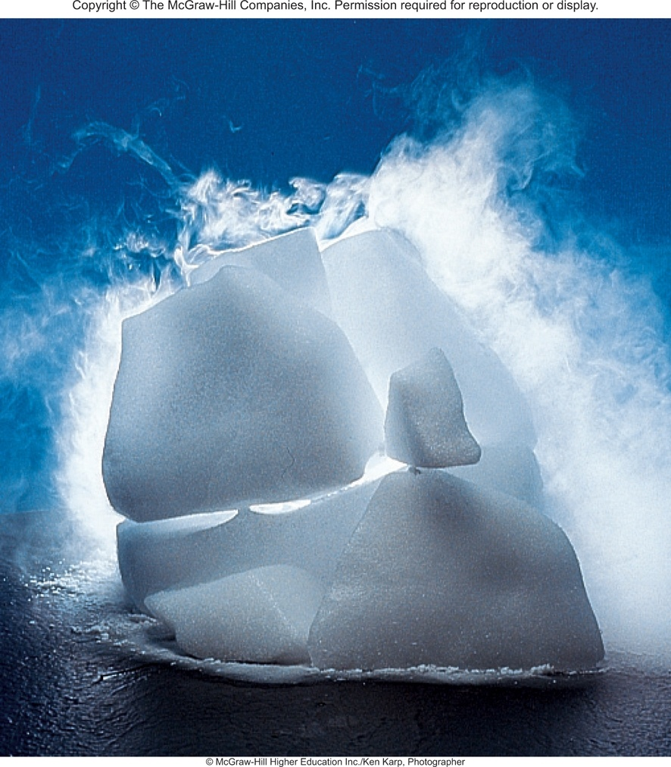
Phase Diagram of CO₂

Slide 27
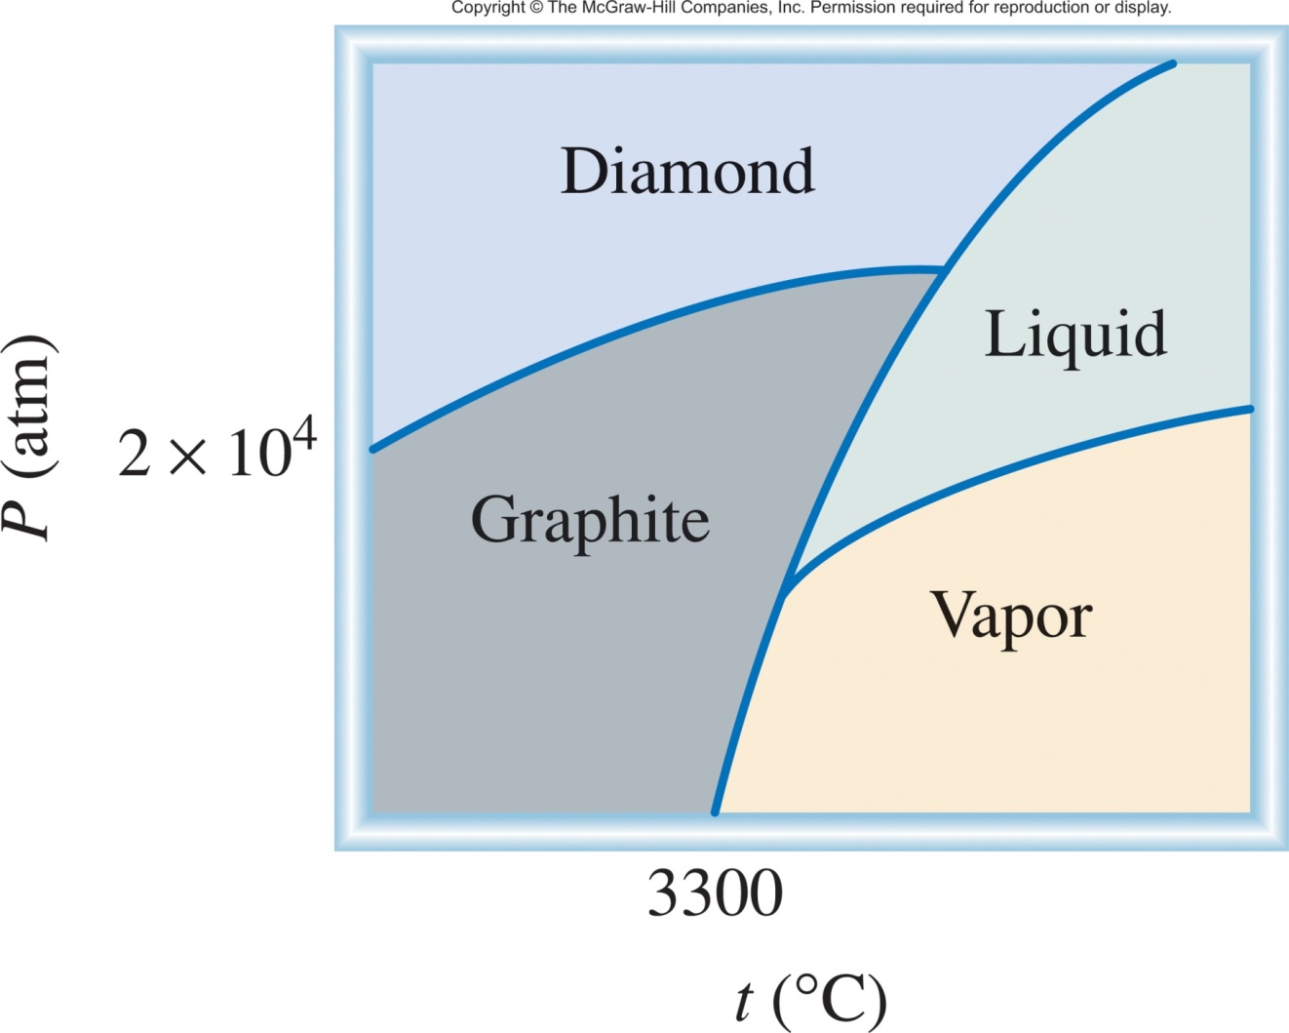
Phase Diagram of Carbon

Slide 28
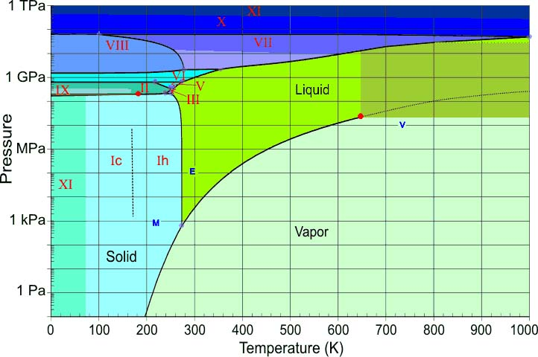
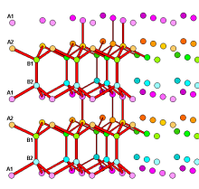
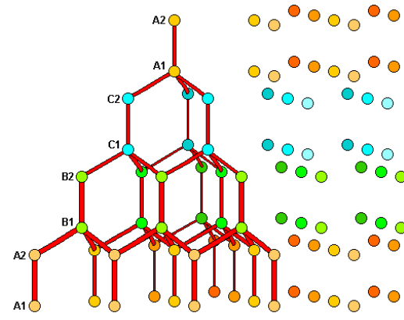
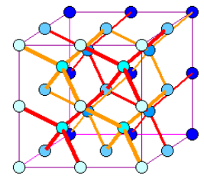
Actual Phase Diagram of Water
I_{h} phase
I_{c} phase
ICE VII phase

Slide 29
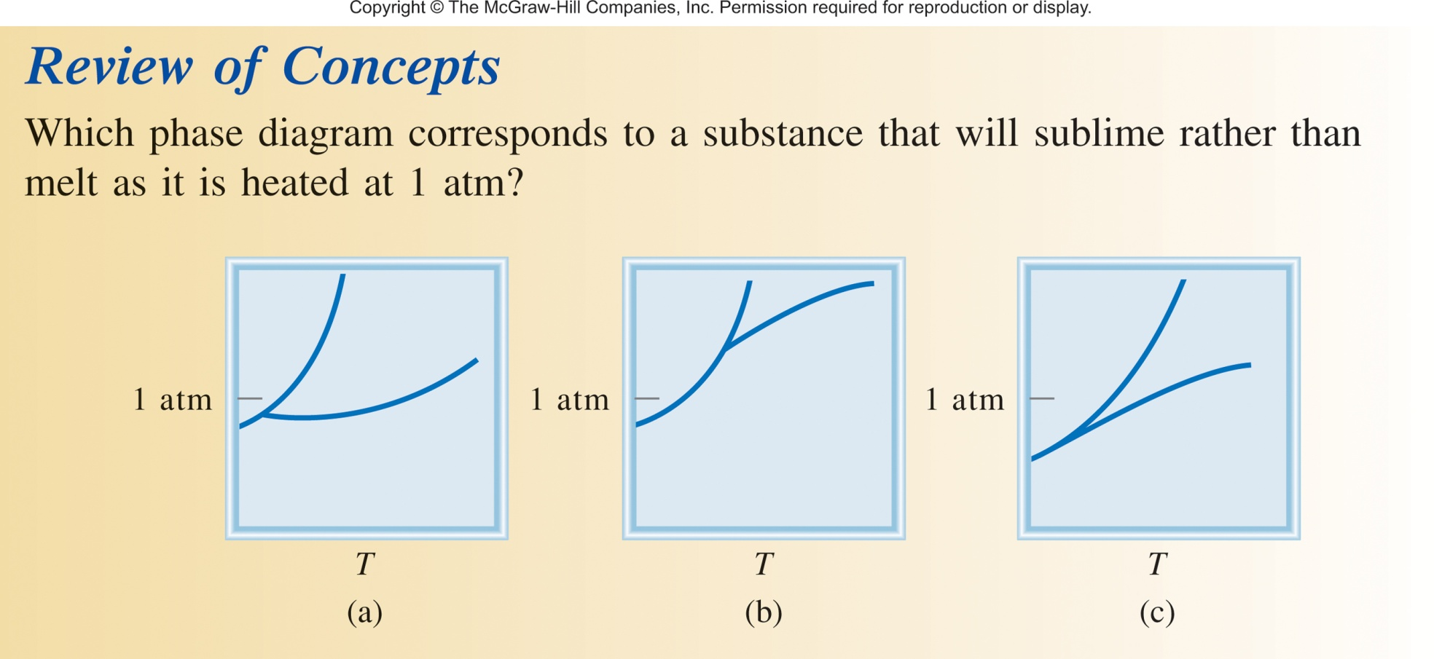
Phase Diagram Review

Slide 30
Chapter 11
Ch 11
Page 467

