Slide 1
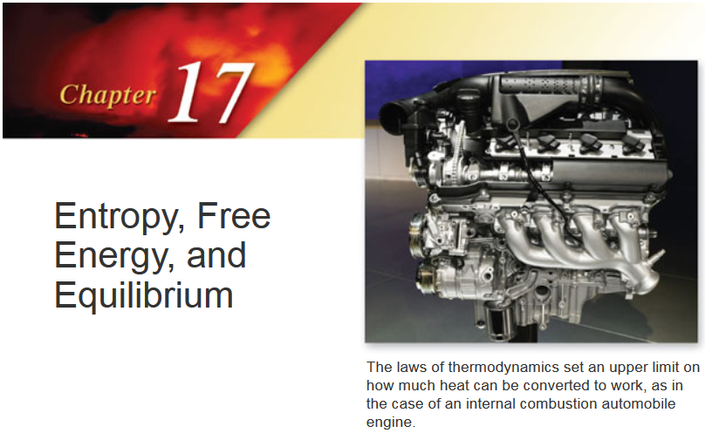

Slide 2
Thermodynamics
Ludwig Boltzmann (1844 – 1906) who spent much of his life studying statistical mechanics died by his own hand. Paul Ehrenfest (1880 – 1933), carrying on his work, died similarly. So did another disciple, Percy Bridgman (1882 – 1961).
Perhaps it would be wise to approach this subject with caution.
David Goodstein

Slide 3
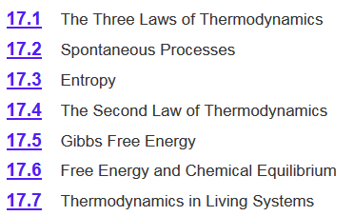
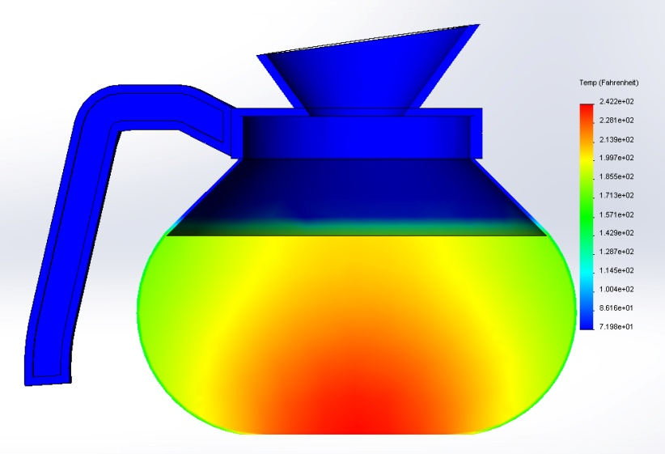

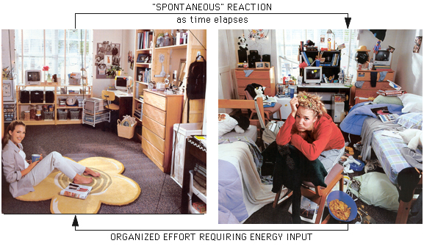
Chapter 17

Slide 4
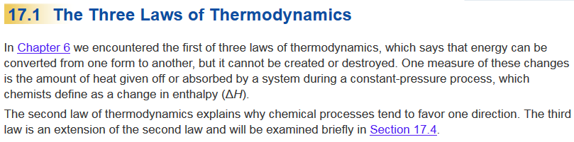
Chapter 17

Slide 5
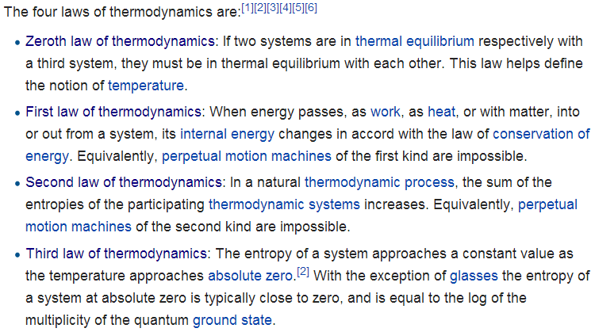
Laws of Thermodynamics
http://en.wikipedia.org/wiki/Laws_of_thermodynamics
Chapter 6
Chapter 17
Fourth law of thermodynamics: Emergent complexity?

Slide 6
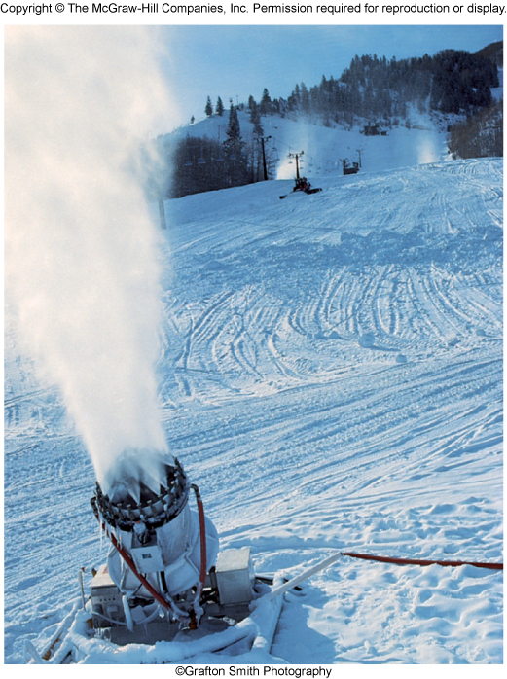
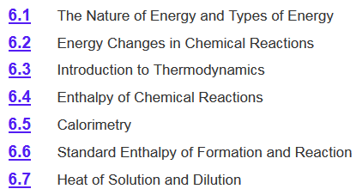
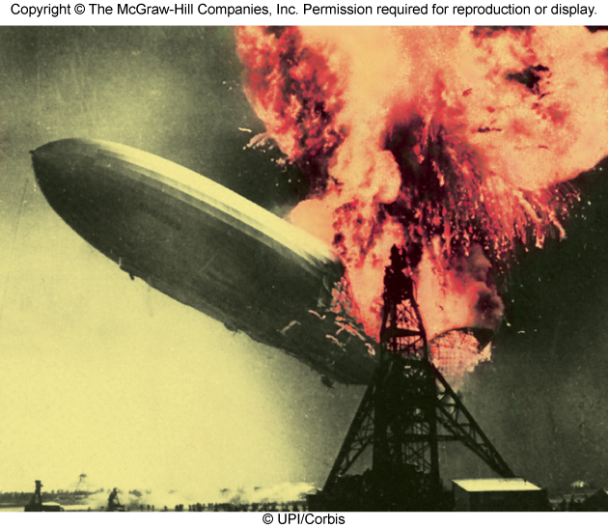
Chapter 6 Review

Slide 7

Chapter 6 Review
Thermodynamics - The study of the relationship between heat, work, and other forms of energy of a system at equilibrium.
Carnot cycle
Heat Engines
Refrigerators
Thermochemistry –
The thermodynamics of chemical reactions.
The study of heat change in chemical reactions.
Predicts whether a particular reaction is energetically possible.
Does not say whether an energetically feasible reaction will actually occur as written.
Thermodynamics tells nothing about the rate of the reaction or the pathway by which it will occur.

Slide 8
Chapter 6 Review
Exothermic process is any process that gives off heat – transfers thermal energy from the system to the surroundings.
2H₂ (g) + O₂ (g) 2H₂O (l) + energy
H₂O (g) H₂O (l) + energy
Endothermic process is any process in which heat has to be supplied to the system from the surroundings.
energy + 2H₂O (l) 2H₂ (g) + O₂ (g)
energy + H₂O (s) H₂O (l)

Slide 9
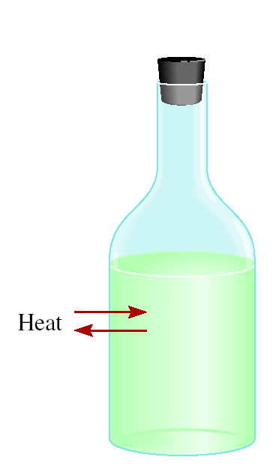
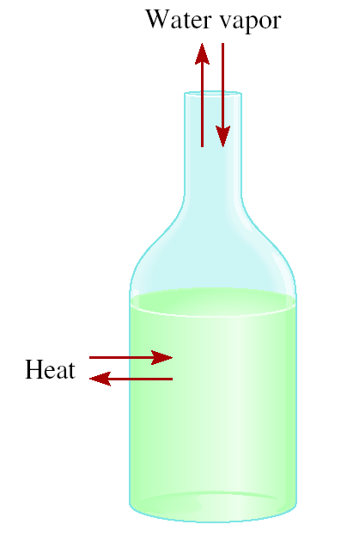

Chapter 6 Review
The system is the specific part of the universe that is of interest in the study.
surrounding
system
open
closed
isolated
Exchange:
mass & energy
energy
nothing

Slide 10
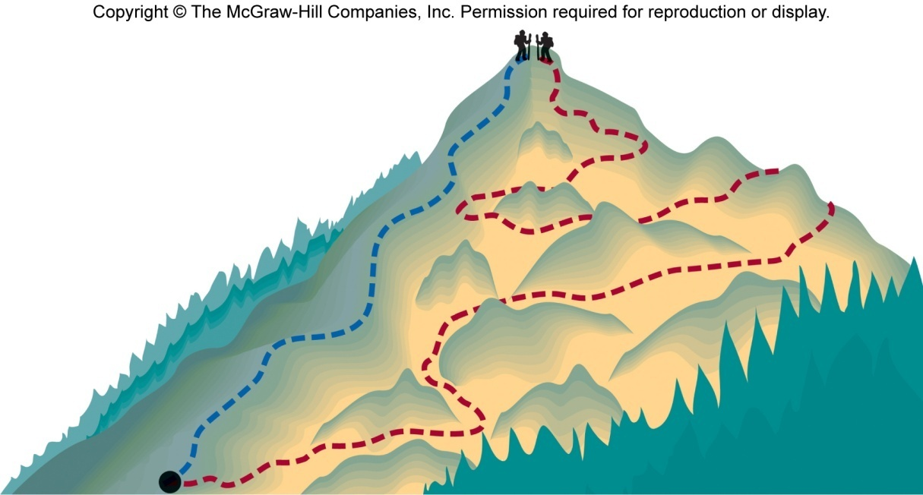
Chapter 6 Review
State of a system is the values of a set of measurable properties sufficient to determine all properties of a system.
State functions are properties that are determined by the state of the system, regardless of how that condition was achieved.
Potential energy of hiker 1 and hiker 2 is the same even though they took different paths.
State functions: temperature, pressure, volume, density, altitude, enthalpy, Gibbs free energy, and entropy.

Slide 11
Chapter 6 Review
First law of thermodynamics – energy can be converted from one form to another, but cannot be created or destroyed.
This law can be stated as, “The combined amount of energy in the universe is constant.”
The first law is also known as the Law of Conservation of Energy.
  Energy is neither created nor destroyed in chemical reactions and physical changes.

Slide 12

Chapter 6 Review
First law of thermodynamics – energy can be converted from one form to another, but cannot be created or destroyed.
internal energy (U) = kinetic + potential
ΔU_{system} + ΔU_{surroundings} = 0
ΔU = U_{final} – U_{initial}
or
ΔU_{system} = -ΔU_{surroundings}
C₃H₈ + 5O₂ 3CO₂ + 4H₂O
Exothermic chemical reaction!
Bond energy lost by combustion = Energy gained by the surroundings
system
surroundings

Slide 13

Chapter 6 Review
First law of thermodynamics – energy can be converted from one form to another, but cannot be created or destroyed.
internal energy = kinetic + potential
The energy of a system can change by the transfer of work and/or heat between the system and its surroundings.
ΔU = U_{final} – U_{initial}
q = heat
w = work
ΔU = q + w
w = -PΔV when a gas expands against a constant external pressure
at constant pressure
ΔH = q
Enthalpy (H) is used to quantify the heat flow into or out of a system in a process that occurs at constant pressure.

Slide 14
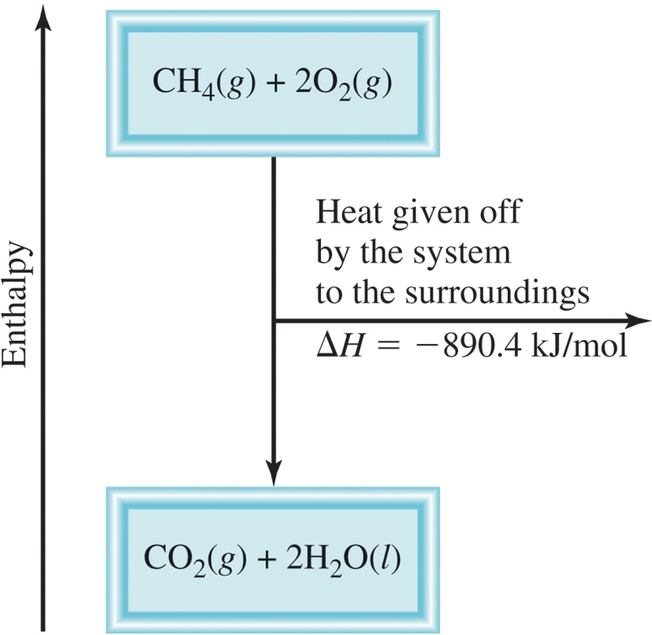
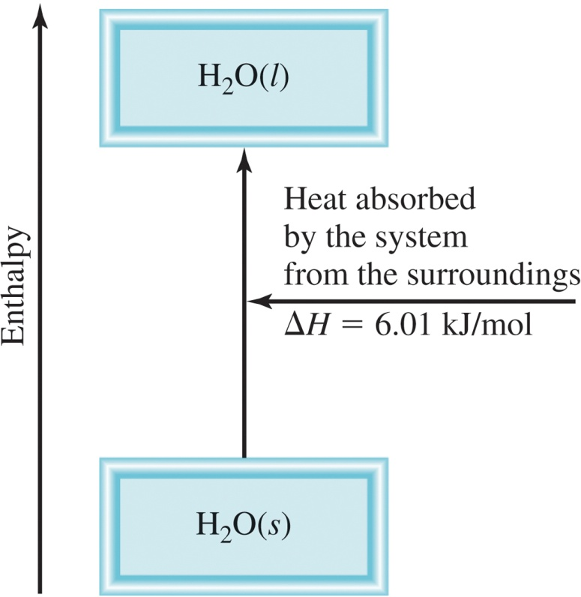
Chapter 6 Review
Enthalpy (H) is used to quantify the heat flow into or out of a system in a process that occurs at constant pressure.
ΔH_{rxn} = H_{products} – H_{reactants}
ΔH_{rxn} = heat given off or absorbed during a reaction at constant pressure
Exothermic
Endothermic
H_{products} < H_{reactants}
H_{products} > H_{reactants}
ΔH < 0
ΔH > 0

Slide 15
Chapter 6 Review
Thermochemical equations are a balanced chemical reaction and the ΔH value for the reaction.
  For example, this is ice melting:
H₂O (s) H₂O (l)
ΔH = 6.01 kJ/mol
ΔH > 0
System absorbs heat
Endothermic
6.01 kJ are absorbed for every 1 mole of ice that melts at 0⁰C and 1 atm.

Slide 16
Chapter 6 Review
Thermochemical equations are a balanced chemical reaction and the ΔH value for the reaction.
  For example, this is methane burning:
CH₄ (g) + 2O₂ (g) CO₂ (g) + 2H₂O (l)
ΔH = -890.4 kJ/mol
ΔH < 0
System releases heat
Exothermic
890.4 kJ are released for every 1 mole of methane that is combusted at 25⁰C and 1 atm.

Slide 17
Chapter 6 Review
Thermochemical equations are a balanced chemical reaction and the ΔH value for the reaction.
  For example, this is methane burning:
CH₄ (g) + 2O₂ (g) CO₂ (g) + 2H₂O (l)
ΔH = -890.4 kJ/mol
Experimentally Determined
ΔH_{rxn} = H_{products} – H_{reactants}
no way to measure the absolute value of the enthalpy of a substance
Establish an arbitrary scale with the standard enthalpy of formation (ΔH⁰) as a reference point for all enthalpy expressions.
f

Slide 18
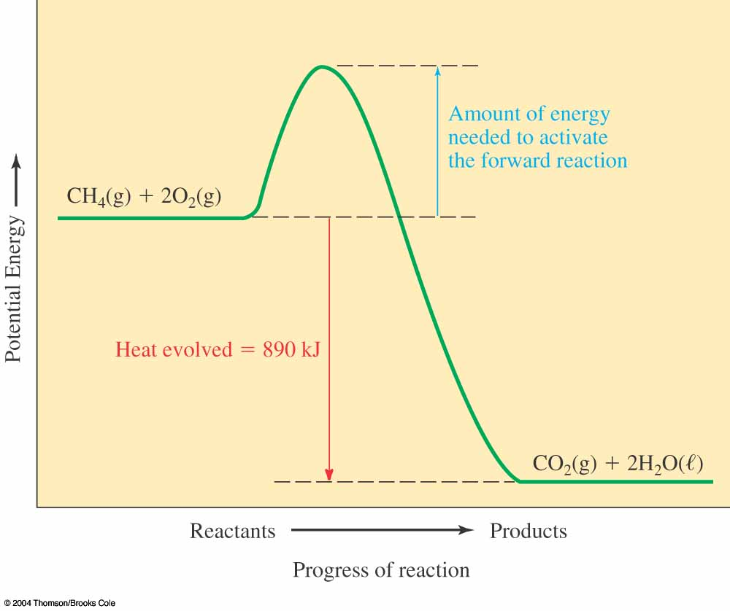
The First Law of Thermodynamics
Exothermic reactions generate specific amounts of heat Q and have a negative enthalpy change:
ΔH = –Q
This is because the potential energies of the products are lower than the potential energies of the reactants.

Slide 19
Chapter 6 Review
Establish an arbitrary scale with the standard enthalpy of formation (ΔH⁰) as a reference point for all enthalpy expressions.
f
Standard enthalpy of formation (ΔH⁰) is the heat change that results when one mole of a compound is formed from its elements at a pressure of 1 atm.
f
I.e. set the standard enthalpy of formation of any element in its most stable form as zero.
ΔH⁰ (O₂) = 0
ΔH⁰ (C, graphite) = 0
f
f
ΔH⁰ (O₃) = 142 kJ/mol
ΔH⁰ (C, diamond) = 1.90 kJ/mol
f
f

Slide 20
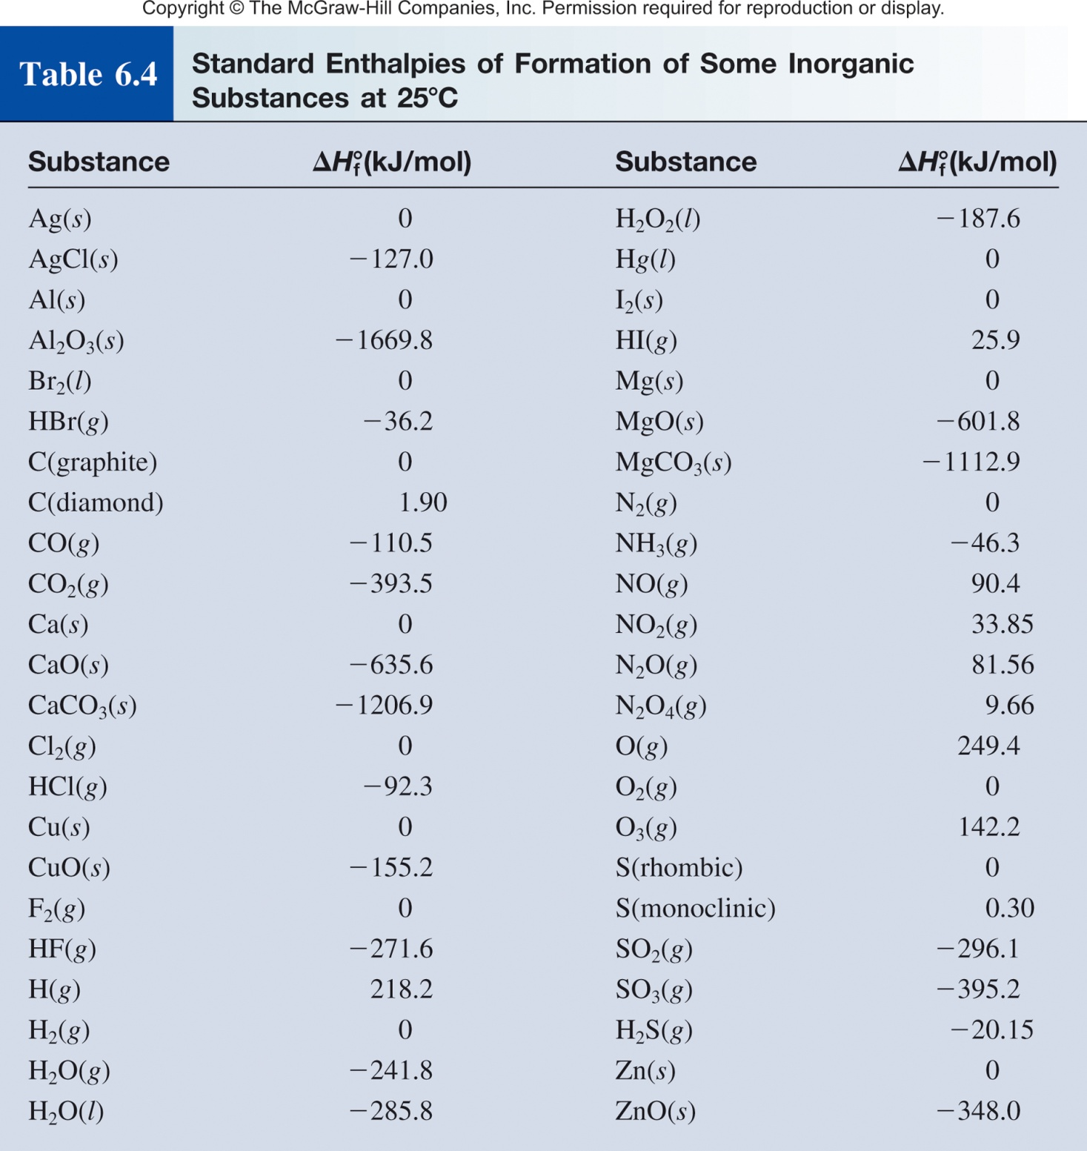
Chapter 6 Review
Standard enthalpy of formation (ΔH⁰) is the heat change that results when one mole of a compound is formed from its elements at a pressure of 1 atm.

Slide 21
Chapter 6 Review
The standard enthalpy of reaction (ΔH⁰ ) is the enthalpy of a reaction carried out at 1 atm.
rxn
aA + bB cC + dD
ΔH⁰
cΔH⁰ (C)
dΔH⁰ (D)
-
aΔH⁰(A)
bΔH⁰ (B)
=
[
+
]
[
+
]
rxn
f
f
f
f
ΔH⁰
=
Σ
nΔH⁰ (products)
-
Σ
mΔH⁰ (reactants)
rxn
f
f
Hess’s Law: When reactants are converted to products, the change in enthalpy is the same whether the reaction takes place in one step or in a series of steps.
(Enthalpy is a state function. It doesn’t matter how you get there, only where you start and end.)

Slide 22
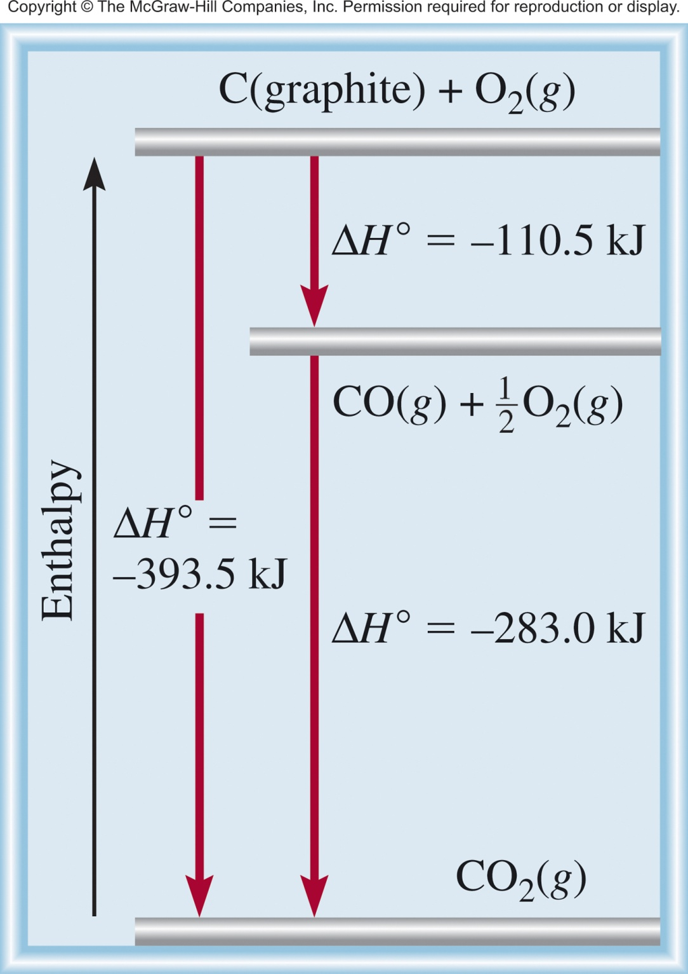
Chapter 6 Review
Direct Reaction
C (graphite) + O₂ (g) CO₂ (g)
Multistep Reaction
C (graphite) + 1/2O₂ (g) CO (g)
CO (g) + 1/2O₂ (g) CO₂ (g)
C (graphite) + O₂ (g) CO₂ (g)

Slide 23
Chapter 6 Review
Enthalpy (H) is used to quantify the heat flow into or out of a system in a process that occurs at constant pressure.
ΔH_{rxn} = H_{products} – H_{reactants}
H_{products} < H_{reactants}
H_{products} > H_{reactants}
ΔH < 0
ΔH > 0
Exothermic
Endothermic
Enthalpically favorable
Enthalpically unfavorable
If we mix reactants and products together will the reaction occur?
Not enough information. We need to know the change in entropy to predict if a reaction will spontaneously occur.

Slide 24
Chapter 17

